Slide 2
Welcome & introduction
Richard Leonard & Deirdre O’Reilly

Slide 3
UK Road safety – working together to build a safer road system.
UK road safety
British Statement
Wales, Scotland and N Ireland
Road safety bodies and charities
Highways England
Local authorities / TfL
Police, Fire and Rescue Service, NHS
International / EU
DVSA / DVLA
Business and industry bodies

Slide 4
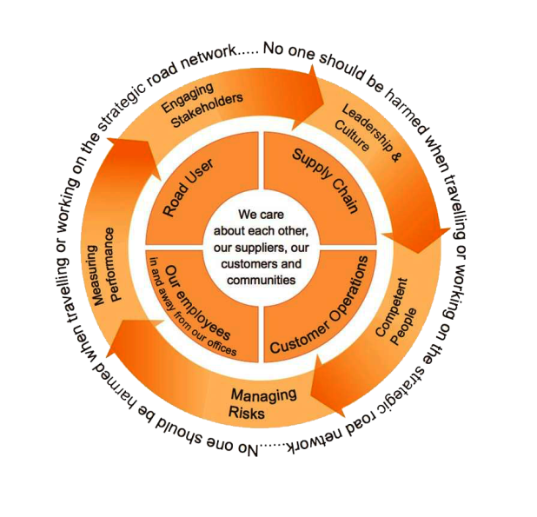
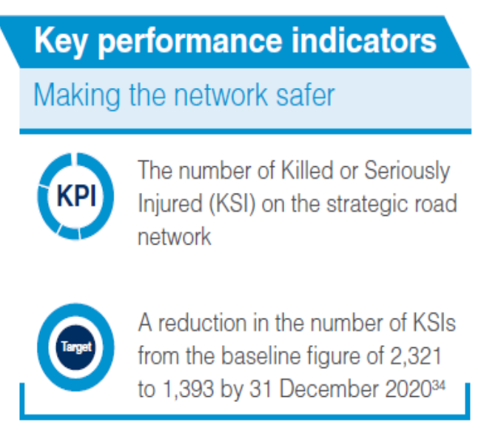
Strategic Direction for Road User Safety
Highways England is a government company charged with operating, maintaining and improving England’s Strategic Road Network. Our ambition is to ensure our major roads are more dependable, durable and most importantly – are safe.
Notes:
Add in 2015 performance data -

Slide 5
Aims of the Event
Develop and access latest research evidence and thinking on how to influence behaviour to improve road safety; learning lessons from other domains.
Develop fresh insights into issues of strategic concern; clarify priorities; and identify opportunities to collaborate.
Encourage and enable greater connections, innovations and inter disciplinarity between the research community and delivery agents.
Encourage effective and long term engagement between the delivery and research communities.

Slide 6
Programme
Focussed around 4 key questions
How can we develop a safety culture and how actively should risk be managed?
What is the balance between changing minds & changing environment?
What does the future look like and what does this mean for behavioural approaches in road safety?
How do we understand & influence the system?

Slide 7
Outputs
A report that captures the substantive discussions from the event
An edited compilation of summaries and learnings
Recommendations of future pathways for effective engagement and delivery of objectives
Edited video of the main presentations and interviews with participants

Slide 8
How the event will work?
Programme is deliberately provocative & outward looking.
Looking for challenges & solutions.
Chatham House rules - presentations and discussions will be recorded – discussion will not be attributable.
Capturing ways forward and encouraging collaborations through - discussion, networking opportunities & recording feedback.

Slide 9
Thanks
Highways England

