Slide 2
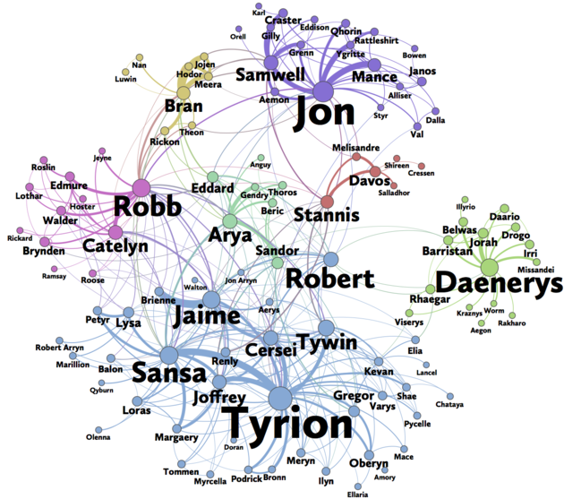

Social Networks
Beveridge and Shian (2016)
Notes:
Social networks. Really interesting topic. Hot topic. Not just talking about online social networks, but old school social networks as well. Online has made it easier to collect data. Faster computers and an abundance of computational tools have made it easier to study social networks.
Let me introduce my topic by telling a joke.

Slide 3
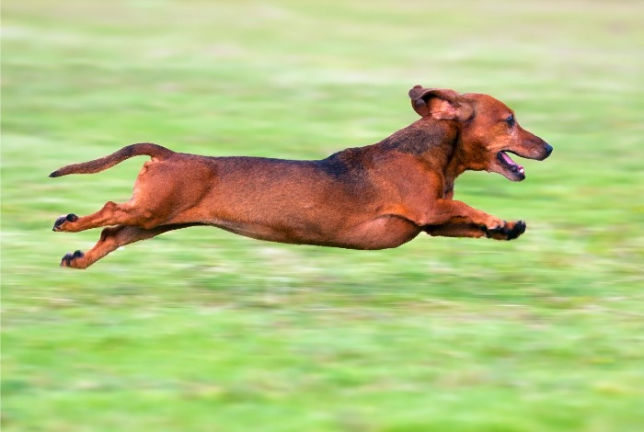
Notes:
The main thing about social networks is that, like many other elements of social life, they are complex. And as with other complex phenomena, it's easier to attempt to understand them indirectly, perhaps through analogy or through metaphor.
The other thing about social networks is that, because there's a widespread suspicion that what's really going on is unknowable, once a metaphor takes hold, it's seldom challenged.
I'm going to talk about two topics in social networks that have been given this kind of metaphorical treatment.

Slide 4
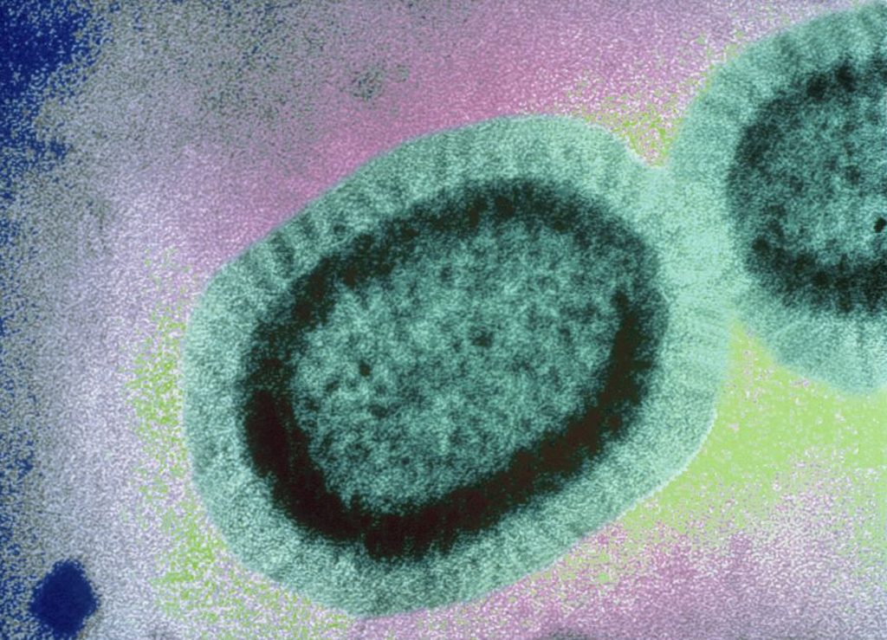
Social contagion
Notes:
The first is social contagion: the claim that ideas, information and behaviour spread through networks like diseases.

Slide 5
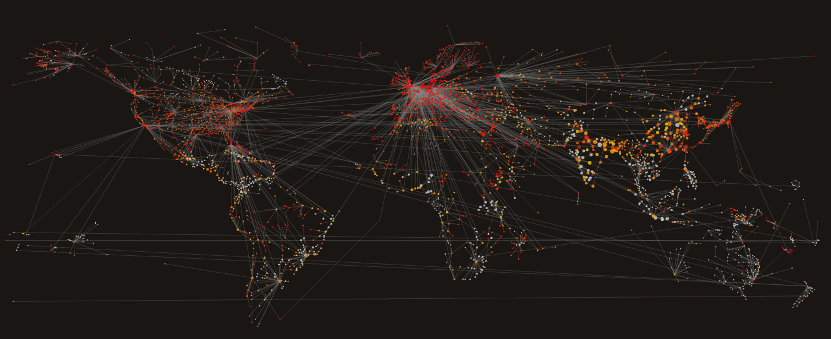
Ideas, information and behaviour spread
through networks like diseases

Slide 6
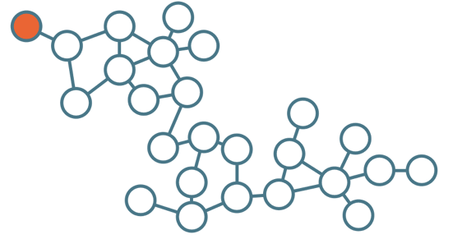
Notes:
Contagion is a word borrowed from epidemiology and it has at its heart a rather simple model of spread by exposure or contact.
An idea, belief or behaviour is adopted because the would be adopter is exposed to it in a previous adopter (or the seed).
Unlike social networks, contagion is something that everyone feels they understand: the idea of epidemic spread has become a part of popular culture.

Slide 7
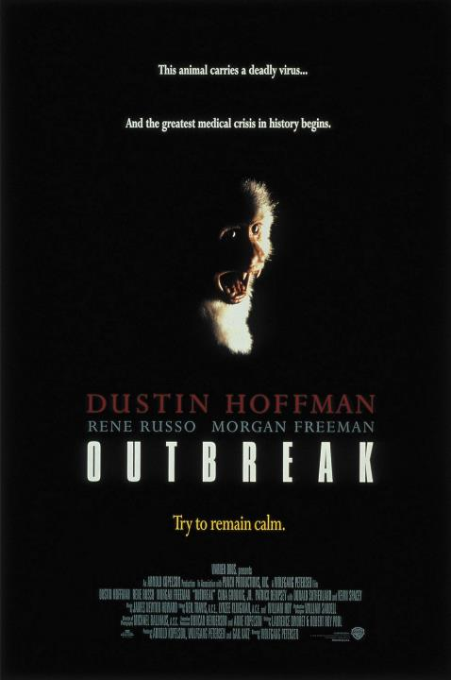
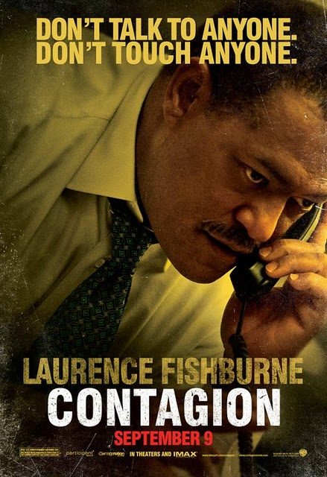
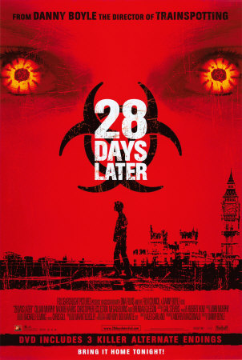
Notes:
Unlike social networks, contagion is something that everyone feels they understand: the idea of epidemic spread has become a part of popular culture.

Slide 8
Notes:
And in spite of the fact that 'contagion' isn't used in medical contexts - 'communicable' is preferred - it's increasingly used in metaphorical contexts.

Slide 9
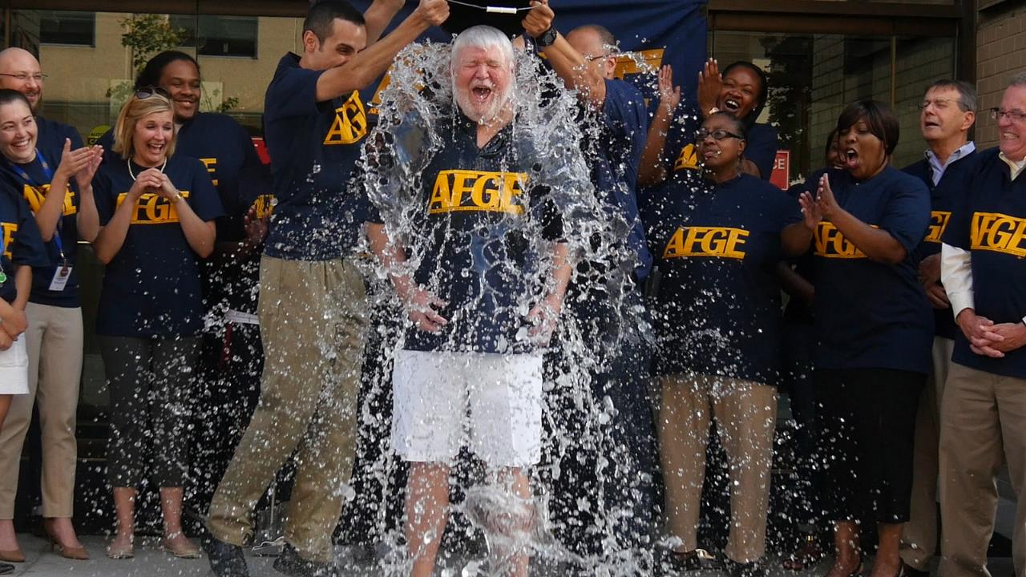
Notes:
And we can all think of lots of putative examples of social contagion, even ones we've been swept up in ourselves.
The trouble is, there isn't much evidence that social networks really do operate in a way that supports the social contagion hypothesis.
Take those examples of social contagion we can all think of. What if we only know about them because they are precisely not representative of how influence spreads in a network?

Slide 10
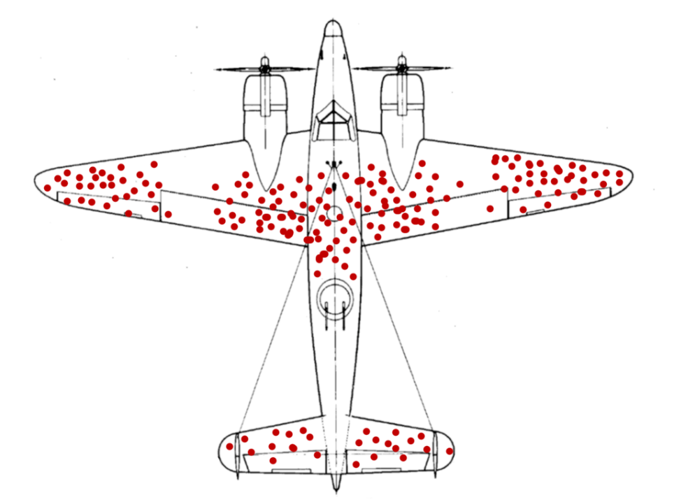
Notes:
This is an example of survivorship bias. In WWII military analysts initially recommended that the patterns of bullet holes in returning military planes be used as a guide as to where to add armour plating. But then it was realised that the returning planes returned not because of where they had been hit, but because of where they hadn't been hit, and the recommendation was reversed: armour was applied where there were no bullet holes.
What we're forgetting here in thinking about viral spread of ideas is all the ideas that failed to spread. We're drawing conclusions based on an unusual proportion of the sample. If you look at the data, or conduct large enough experiments, it turns out that contagions in social networks are very rare.

Slide 11
Diffusion domain | Diffusion mechanic
Yahoo! Kindness | Describe an act of kindness and share with contacts.
Zync | Video sharing – receiver has to adopt service to view video
Secretary game | Player to player sharing
Twitter news stories | Link posting and onward sharing
Twitter videos | Link posting and onward sharing
Friend Sense | Facebook app: player to player sharing
Yahoo Voice | Sharing over Yahoo IM network
Goel et al (2012)
Notes:
Researchers at Yahoo carried out a massive study of online diffusion across a range of different online networks for which they had data. The networks included a 'kindness' app, a video recommendation service, as well as Twitter.

Slide 12
Influences by Cascade Type
Goel et al (2012)
Notes:
This chart shows the frequency of different types of adoption cascade structure. Note that it's a log plot.
For all of the networks studied, the majority of adoptions end at the seed adopter. Fewer than 4% make it more than one hop away from the seed adopter.
In other words, most of these adoptions fizzle out pretty quickly.

Slide 13
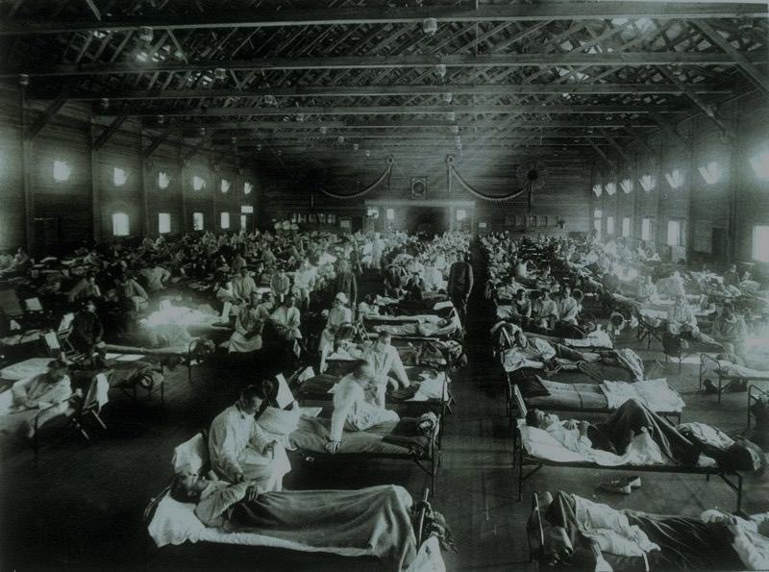
"the majority of all humans who have ever been infected with avian influenza were infected during a single event, namely the 1918 pandemic, during which more than 500 million individuals are thought to have been infected"
By contrast, only around 10% of online adoptions - succesful influences - are found within large cascades.
Notes:
The Yahoo researchers note that "the majority of all humans who have ever been infected with avian influenza were infected during a single event, namely the 1918 pandemic, during which more than 500 million individuals are thought to have been infected." By contrast, only around 10% of all online adoptions - succesful influences - are found within large cascades.

Slide 14

Notes:
This suggests that epidemic-style contagion is, after all, a poor model for the spread of ideas. What's needed is a model that captures the element of agency - influence is subject to a degree of choice on the part of the one influenced.

Slide 15
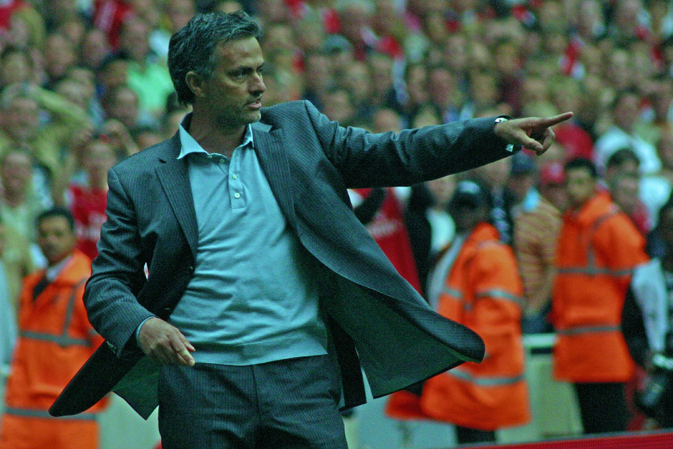
Special People
Flickr: ronmac
Notes:
The second idea about networks I want to contest is that there are certain key individuals that are critical to some of the features of social networks.

Slide 16
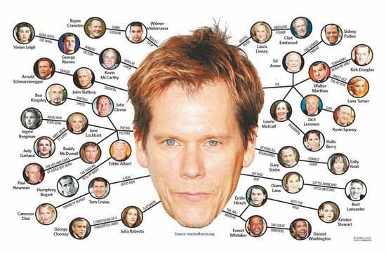
Notes:
It's joined at the hip with the idea of six degrees of separation - or six degrees of Kevin Bacon if you're familiar with that game.
The idea has a chequered history. In one telling, it starts with an experiment run by Stanley Milgram.

Slide 17
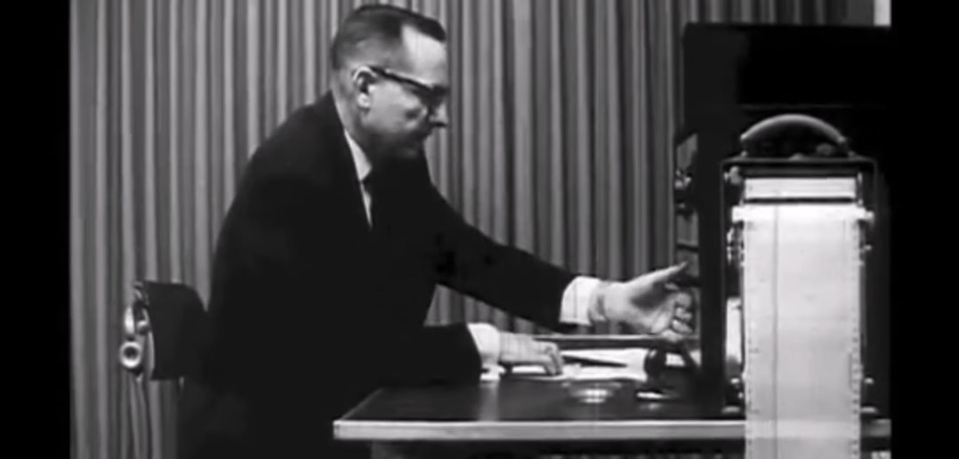
Notes:
Not this experiment, though.

Slide 18
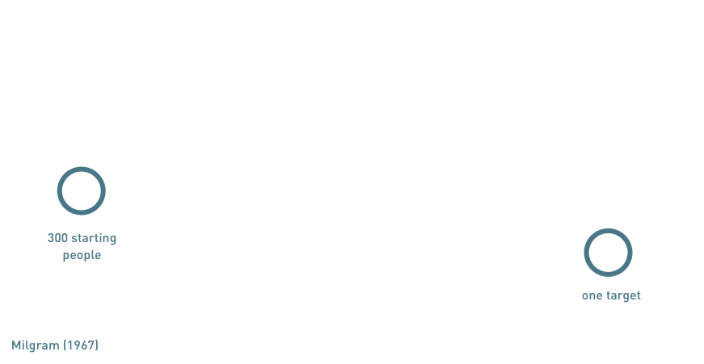

Slide 19
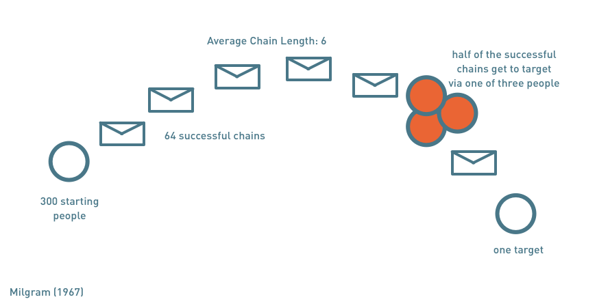

Slide 20
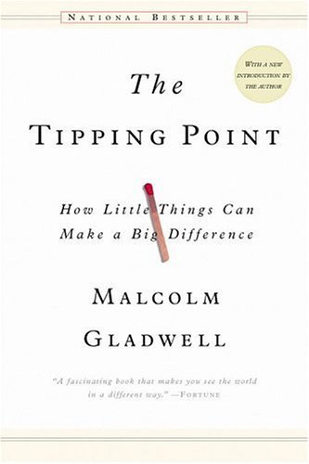
Notes:
The finding was later picked up by Malcolm Gladwell in his book the tipping point. It seemed like everyone was talking about the tipping point at the beginning of the last decade.
The book spawned a massive interest in influencers and practically a whole new way of doing advertising.

Slide 21
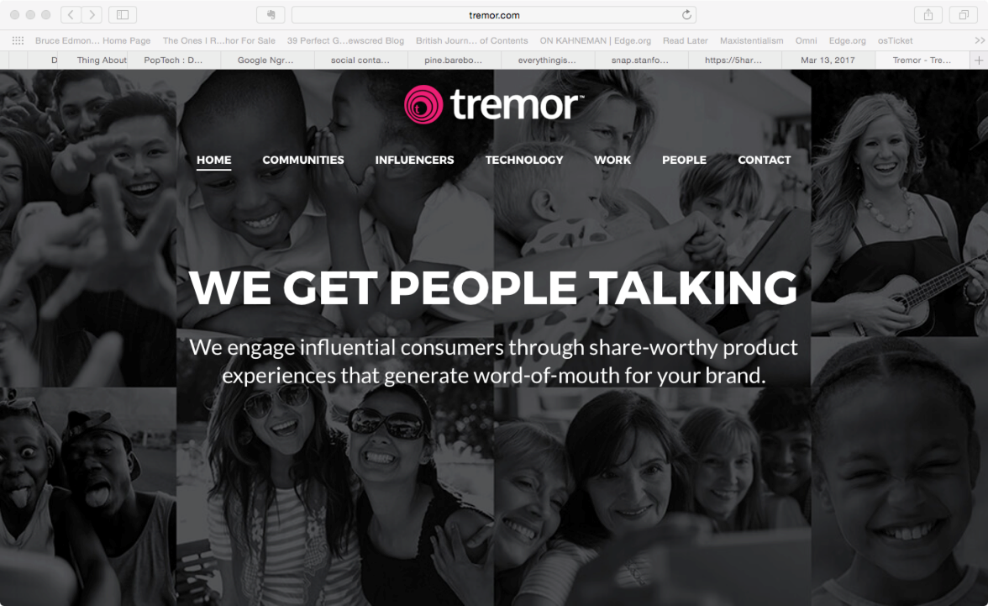
Notes:
This is Tremor, a web site that P&G set up to leverage these special influencers.
Again, the idea that there are these influencers sounds plausible. We can all think of people who are well connected and seem to know everyone, so it just makes sense that stuff like the six degrees depends on them.
Except it doesn't.
Milgram's experiment was small. A more recent attempt to replicate it at scale found the six degrees thing held true - nearly - but the dependence on a small number of highly connected individuals didn't. It turns out the structure of the network is more important.

Slide 22
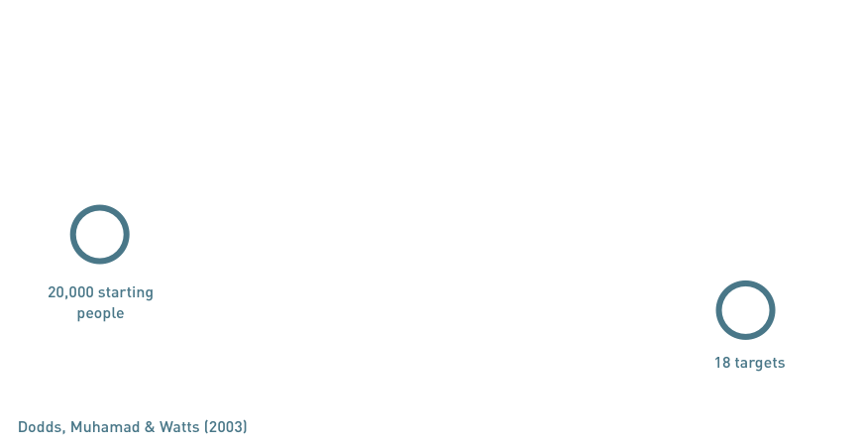

Slide 23
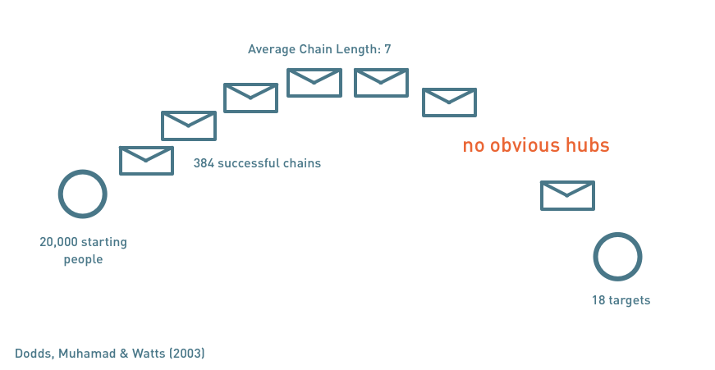
Notes:
But: no hubs
So that's a couple of examples we thought we know about networks but didn't.
The larger point here is that what we think we know about networks shouldn't be allowed to substitute for seeking for empirical or other forms of deeper understanding.

Slide 24


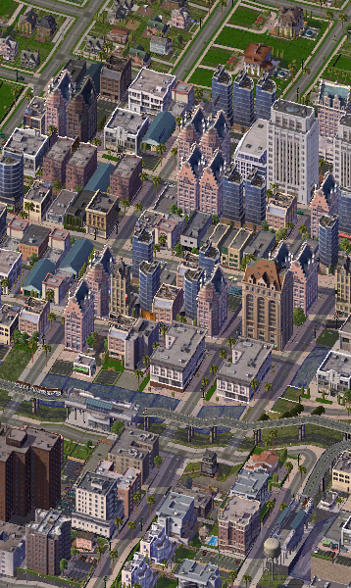
Experiment
Data
Simulation
Flickr: amylovesyah
Notes:
If you're facebook or Google it may be relatively easy to collect data about social networks or conduc massive experiements. For other organisations it can be prohibitively costly. But there is another technique that can shed light: simulation.
I'll talk through a couple of examples of where simulation has been used to understand social phenomena: one from the canon and one of our own.

Slide 25
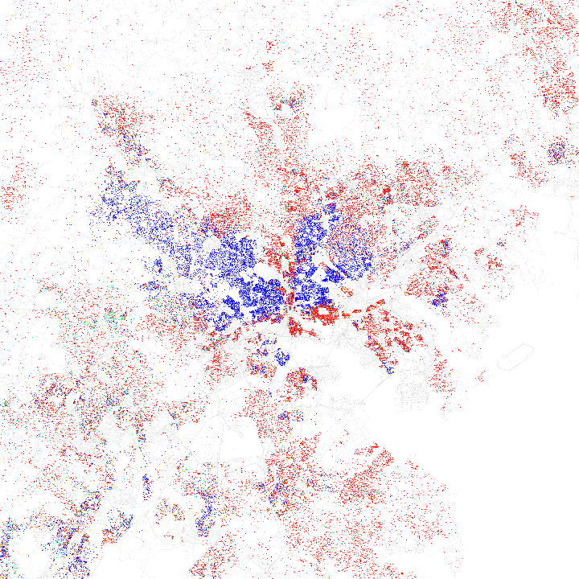
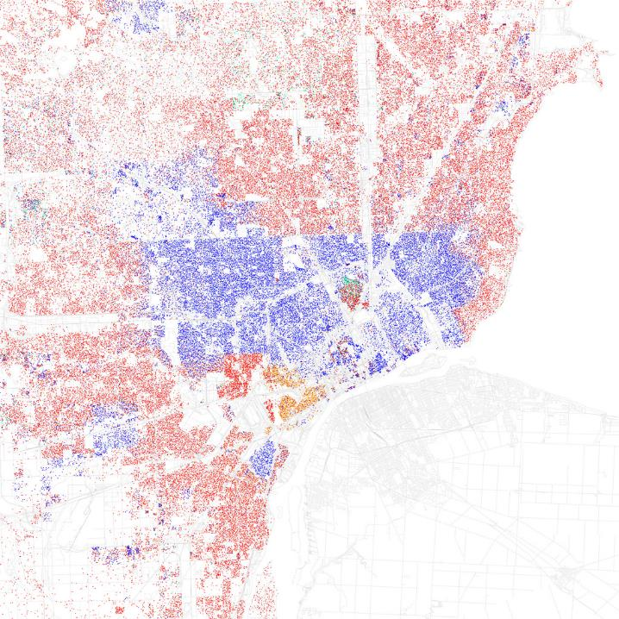
Neighbourhood
Networks
Flickr: walkingsf
Notes:
These are maps of Baltimore and Detroit. The different colours on the maps represent different races.
Why does segregation arise in US cities? What might cause it?
- People are racist
- Governments are racist
- etc

Slide 26
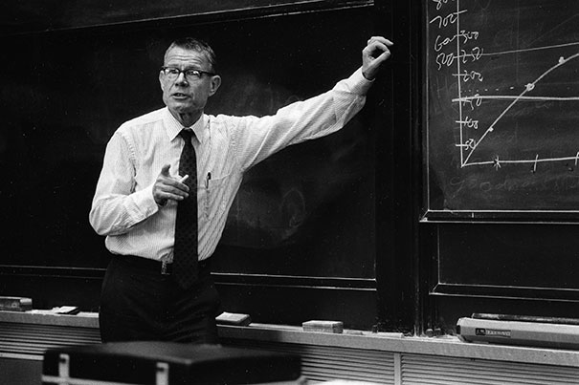
Notes:
This is Thomas Schelling. Nobel Laureate, died at the end of last year. As an aside, he was also a collaborator with Stanley Kubrick on the script for Dr Strangelove. Pioneering work Micromotives and Macrobehaviour. Interested in how individual preferences lead to social effects.
Schelling proposed a simple simulation using coins and paper to shed light on the segregation question. He encouraged people to do it by hand themselves, though it is trivial to do it on a computer.

Slide 27
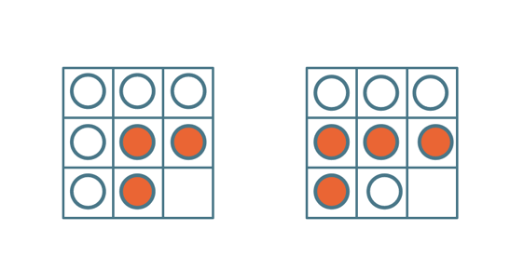
A satisfied agent is one that is surrounded by at least x %(here: 30%) of agents that are like itself.
When an agent is not satisfied, it moves to a randomly chosen vacant location on the grid.
Notes:
This is the setup
[Setup slide]
A satisfied agent is one that is surrounded by at least 30 percent of agents that are like itself.
When an agent is not satisfied, it moves to a randomly chosen vacant location on the grid.
Continue till everyone is satisfied.
What happens? I've followed Schelling's advice and used coin and paper for the first demonstration.

Slide 28
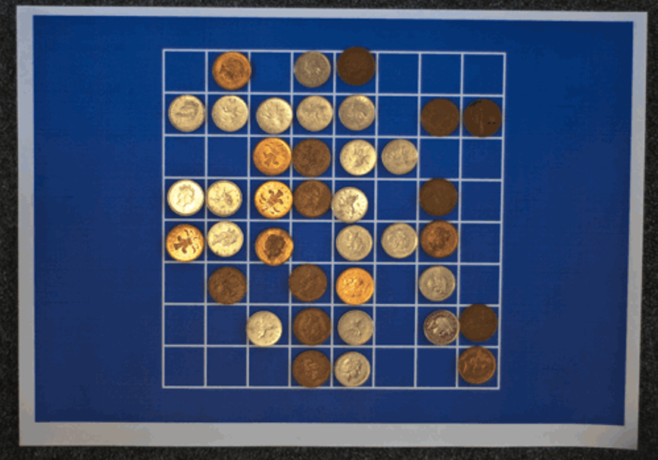
Notes:
You can see the board ends up significantly more segregated.
You can see this more clearly if we scale things up a bit with this computer simulation.

Slide 29
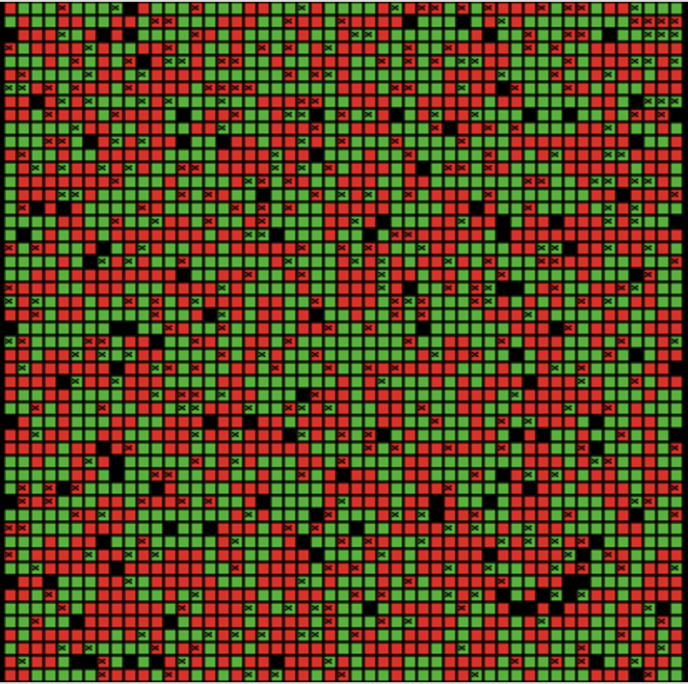
Notes:
Even modest preferences not to have all of one's neighbours be of a different type to oneself lead to segregation.
It's not at all obvious thatthese small prefs will result in this degree of segregation, but they do. Simulation doesn't prove that this is what is happening, but it does show that it is possible, which we might have ruled out otherwise.

Slide 30
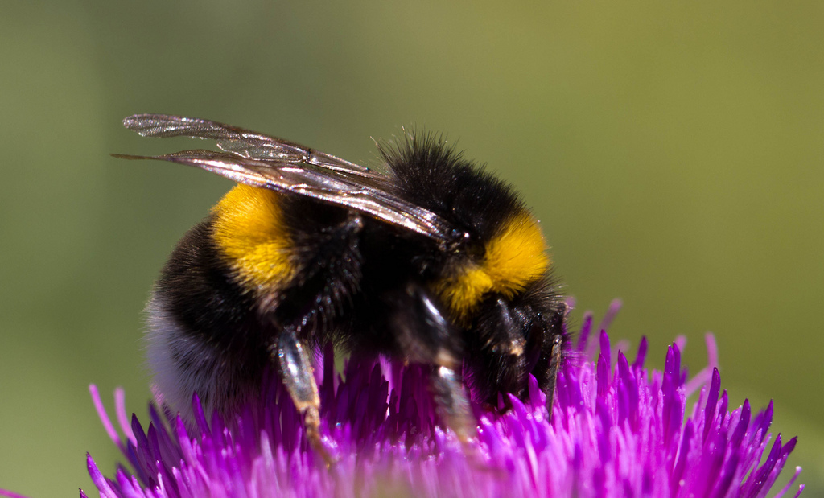
Buzz
Notes:
Another example from our own work.
We work with advertising clients. They are interested in what makes advertising more effective. Social buzz. It's related to the ideas of contagion and influence we talked about earlier. They even incorporate it into their campaigns. Getting people to talk about brands to one another will enhance advertising effect.

Slide 31
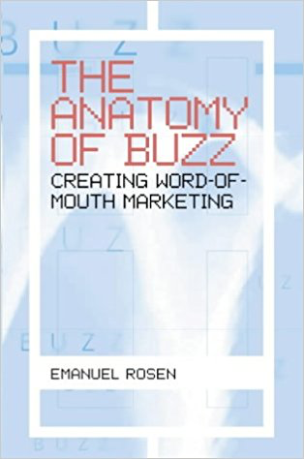
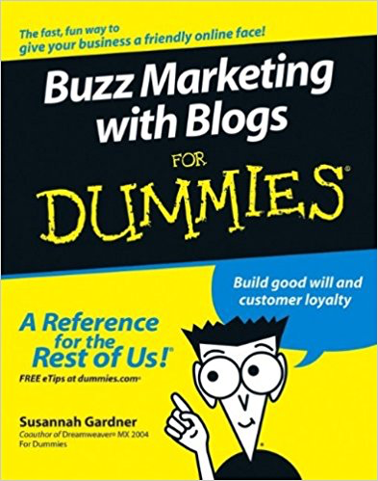

Notes:
Again, it's spawned a bit of an industry

Slide 32
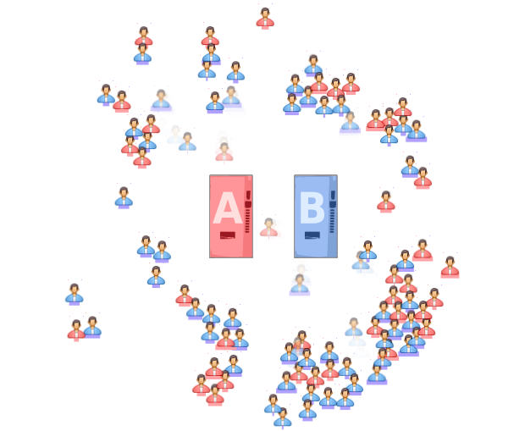
Notes:
Simple consumer market model. Agents can choose between two brands based on preference. They can also talk to one another about what brands they buy and adjust their prefs in line with people they are connected to in their social networks. Advertising delivers messages to the population that adjusts their prefs in favour of teh advertised brand.

Slide 33
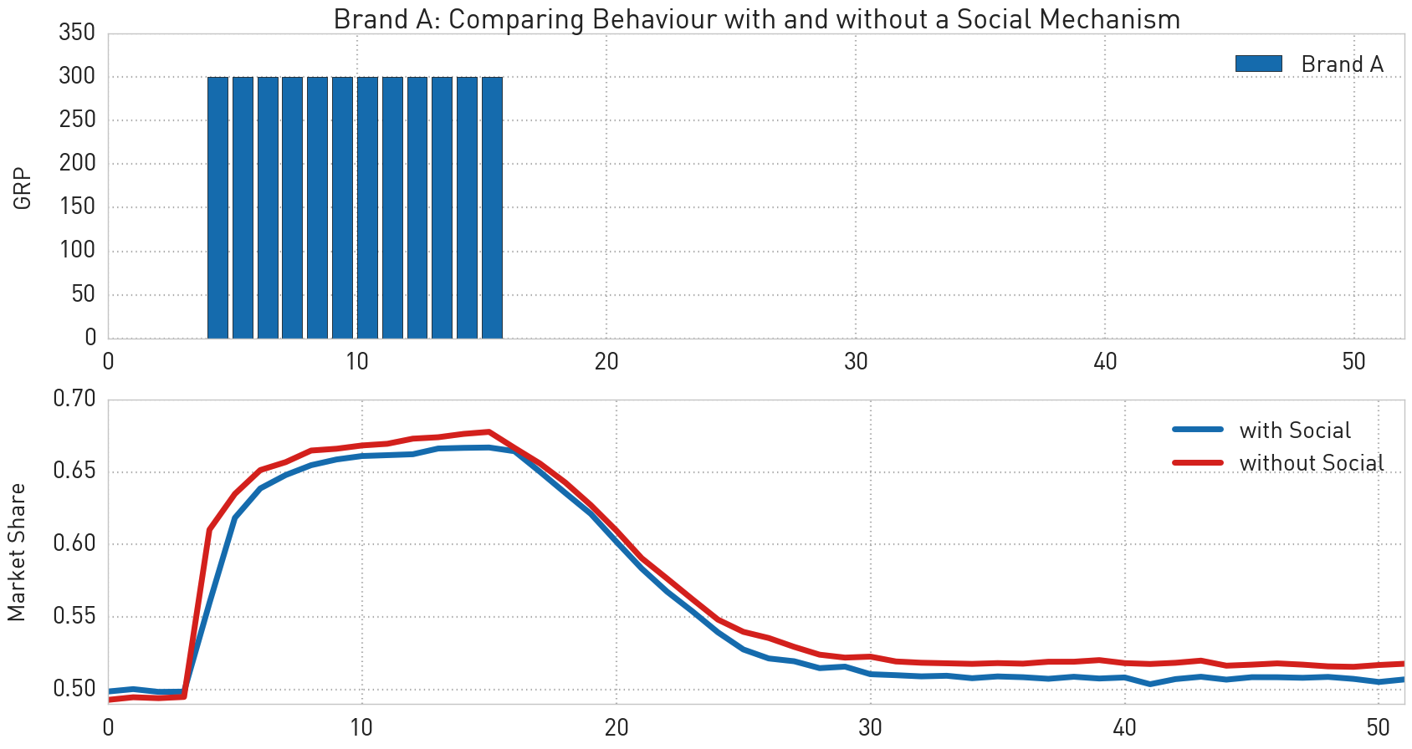
Notes:
This is what the market looks like without the social chatter. Advertising boosts sales.
This is what happens when agents can talk to one another and compare notes.
When we first looked at this we thought we had made a mistake. In part bec we were in the grip of the contagion model of spread. But there's no mistake.
Social chatter has a dampening effect on advertising.

Slide 34
Where are our blind spots and what is our received wisdom about complex network phenomena?
How do we characterise behaviour in the networks we are interested in?
Where we know we don’t know, do we have - or can we collect - data?
If data is limited, what can we simulate?

