Slide 1
Illusions of safety;
Safety Management Systems in the aviation sector
Dr Rob Hunter
Head of Flight Safety
British Airline Pilots Association

Slide 2
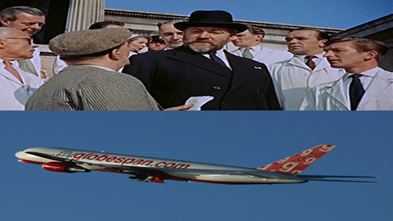

Slide 3
Safety Management Systems (SMS)
Increasing reliance on SMS for future regulatory strategy
Its elemental form is; hazard identification, gathering and interpreting risk data , mitigating risks so that some level of safety is maintained
Enthusiastically promoted by regulators
For the most part, enthusiastically adopted by airlines
Can unravel terribly in the case of an accident

Slide 4
Advantages and disadvantages of the SMS approach
Advantages –
Bespoke, high fidelity risk assessment, rather than a categorical risk assessment
Operators, especially in rapidly advancing fields, are best placed to understand the risk
Disadvantages –
Difficult to formulate + very difficult to regulate
The source intellectual construct can become conflated with other constructs -> confusion and disguised forms of deregulation

Slide 5
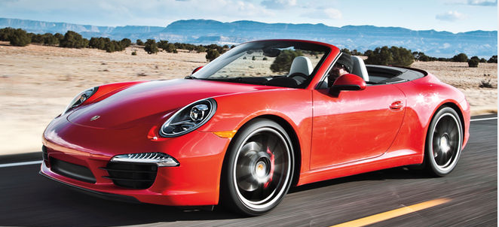
Let us think about an SMS approach to setting the speed limit/s for cars “a car shall not travel so fast so as to affect the safety of the car, its occupants and other road users”

Slide 6
Let us say that the speed limit for these cars shall be the speed from which they can stop at within a given distance
A The distance is determined by an independent body (IB). E.g. “nobody can go faster than the speed from which they can stop in 300 ft” and..
..the measurement of the distance is by the IB
Or
..the measurement of the distance is performed by the manufacturer or owner
B The distance is determined by the manufacturer or owner of the car. E.g. “I have decided that I will not go faster than the speed from which I can stop in 400ft” and..
..the measurement of the distance is performed by the IB
Or
..the measurement of the distance is performed by the manufacturer or owner

Slide 7
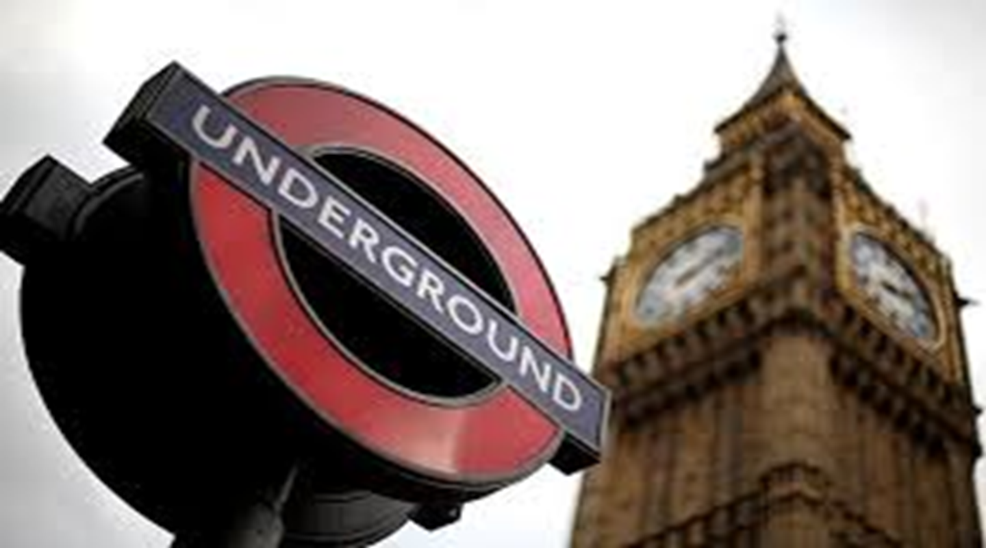
Productivity vs safety
Conflicting interest held by the designers/enablers of the SMS
Regulatory self-interest
Who owns the risk vs who has jeopardy for the risk -> Blame management systems
Owned science
Reverse engineering
Commercial band waggons
Not learning the lessons from history

Slide 8
If instead of speed limits and policemen with speed cameras we relied on drivers self-reports of their speeding violations, might drivers speed more often?

Slide 9
The control of pilots’ hours of duty
3 components to the regulations
An overarching rule set that pilots must not fly with “such fatigue” as could endanger the safety of the flight (N.B. there is no quantitative definition of the level of “such fatigue” and no airline has ever been prosecuted for breach)
A subordinate, so-called “prescriptive rule” set, a very complex esoteric rule set that describes quantitatively what is allowed. E.g. max 900 hrs per year.
An SMS exemption from the prescriptive rule set

Slide 10
Modelling pilot rosters Karolinska Sleepiness Scale; 1= Extremely Alert…7 = Sleepy, 8 = Sleepy, some effort to keep awake, 9 = Extremely Sleepy, fighting sleep
At this point the pilot is landing the aircraft.
KSS= 8.2; probability of involuntary sleep c.20%

Slide 11
In summary, conflicting interest is the fly in the ointment of aviation safety management systems
For more information please google “Illusions of safety LSE”
robhunter@balpa.org

