Slide 1
Safety Cultures and Road Safety
Nicola Christie

Slide 2
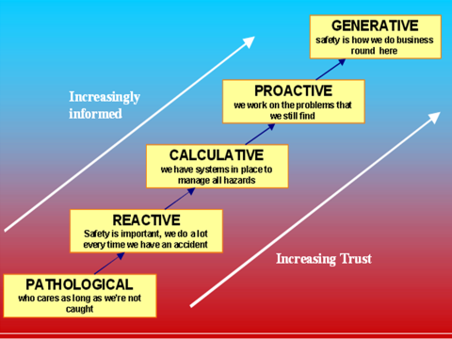
“A few more people need to be injured before we can do something”

