Slide 1
Safety Culture in Industry
24pt Subtitle here
Saul Jeavons – The Transafe Network

Slide 5
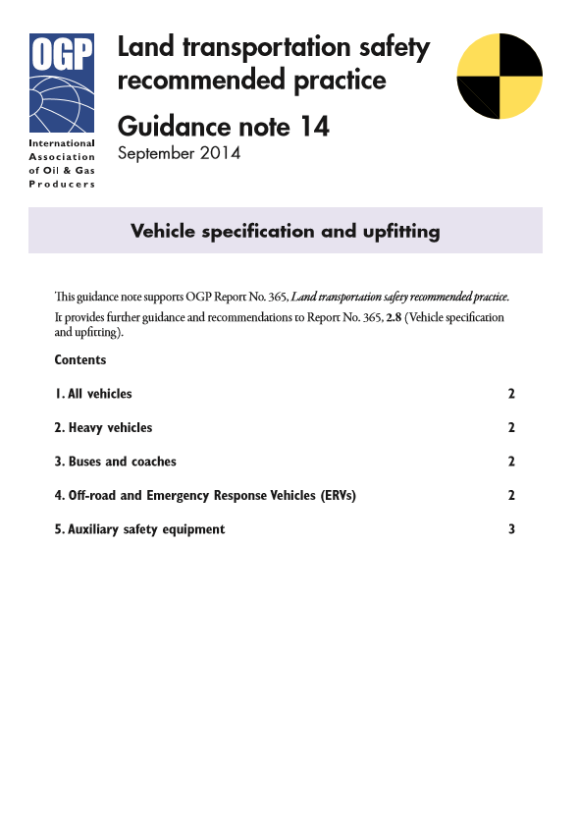

Slide 6
Encouraging Good Practice
NCAP scores
ADAS – Advanced Driver Assistance Systems
Company Specification
Recommended Specification
Promote safer vehicles

Slide 7
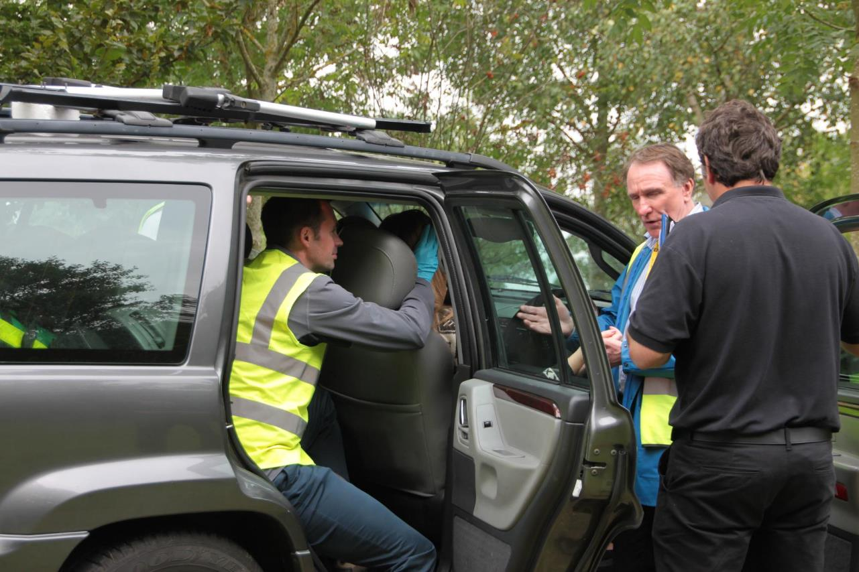

Slide 8
Root Causes vs Actions Generated

Slide 9
Root Causes vs Actions Generated

Slide 10
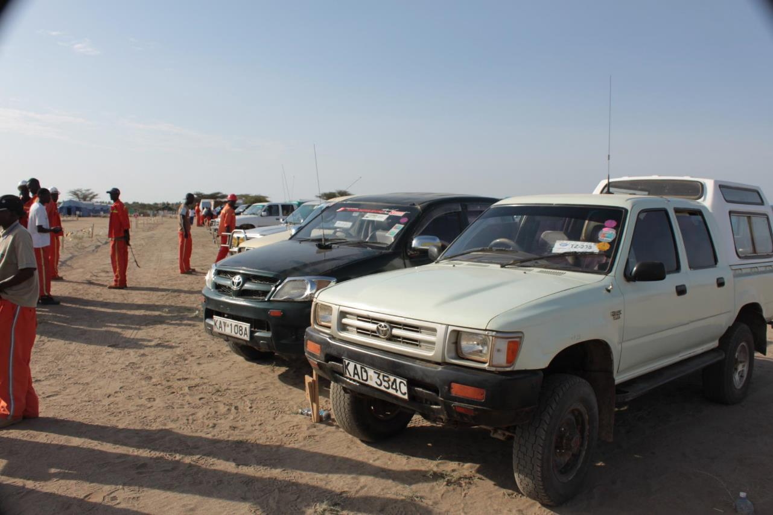

Slide 11
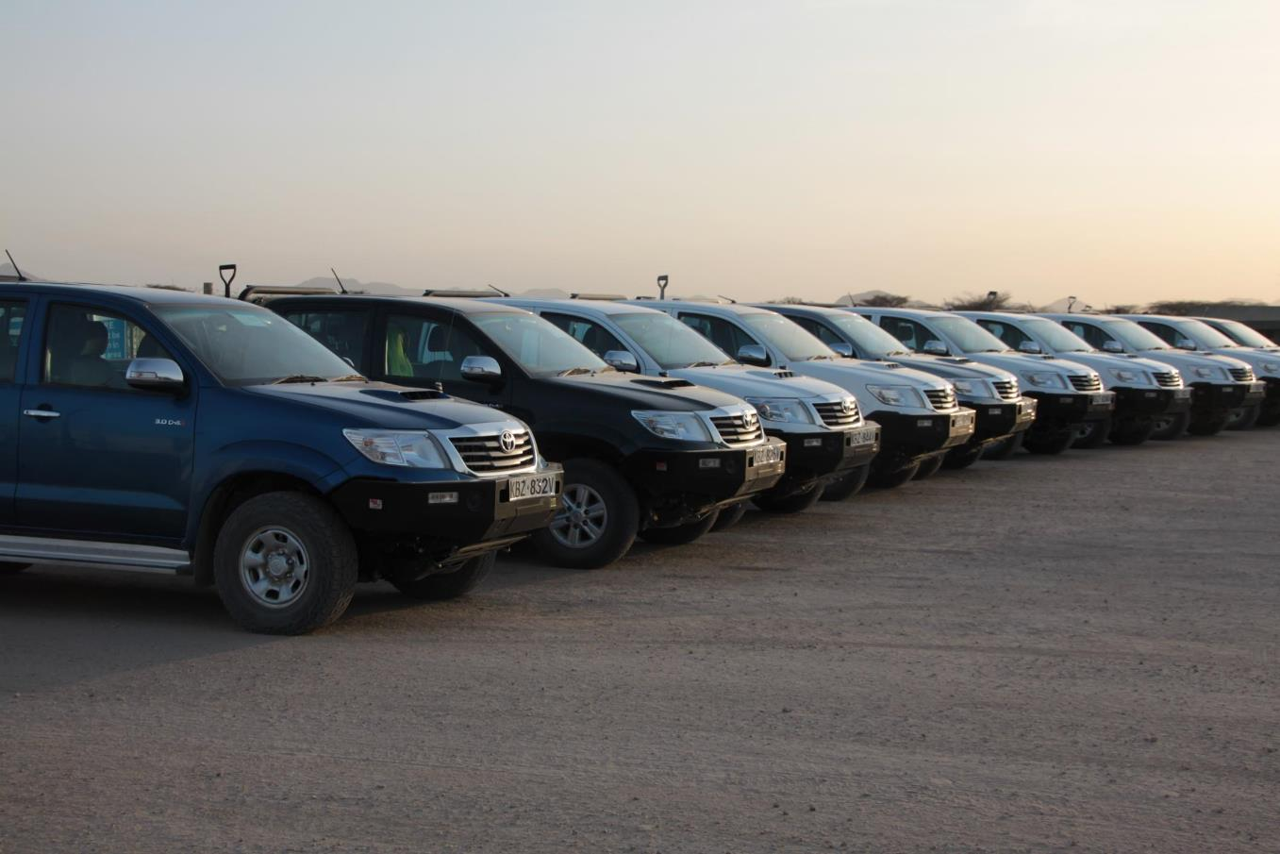

Slide 12
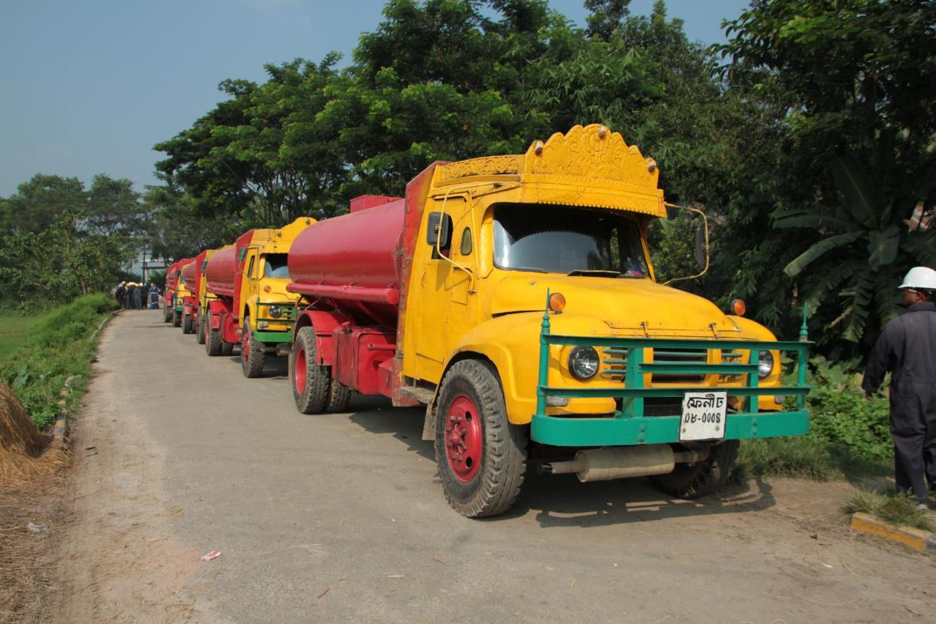

Slide 13
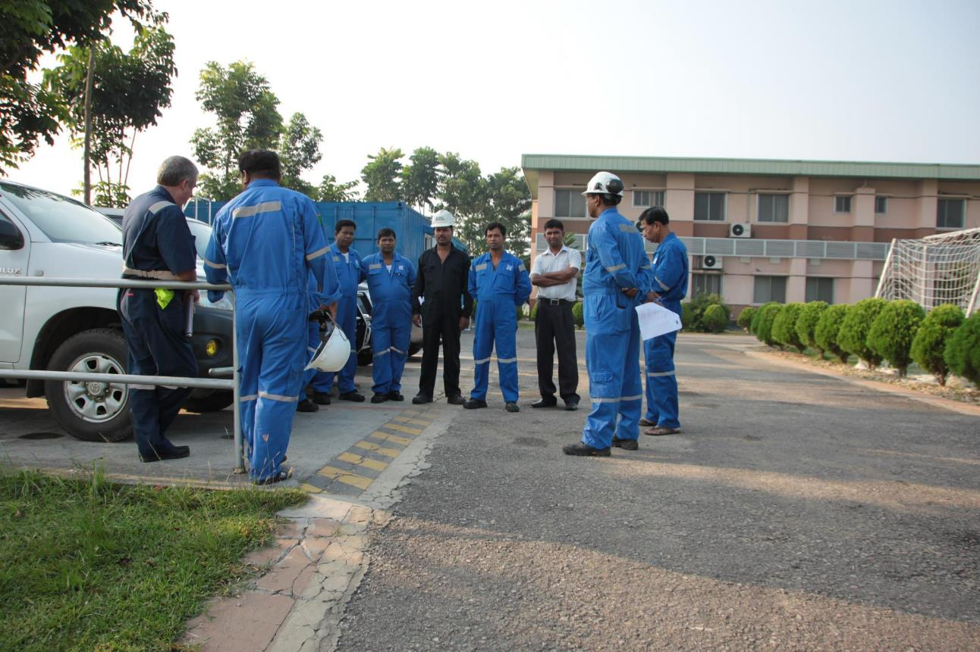

Slide 14
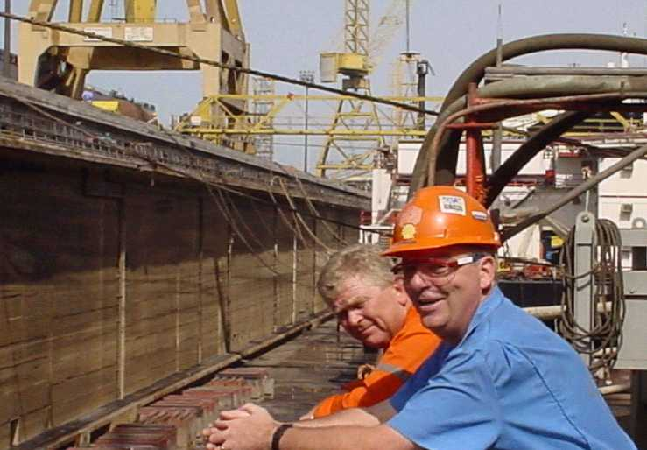

Slide 15
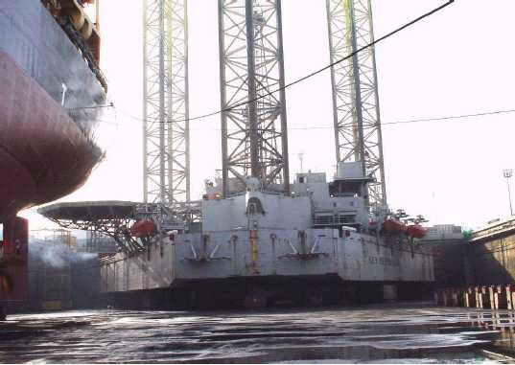

Slide 16
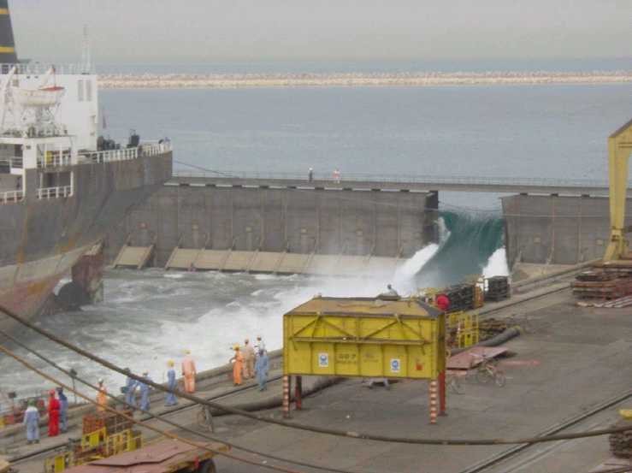

Slide 17
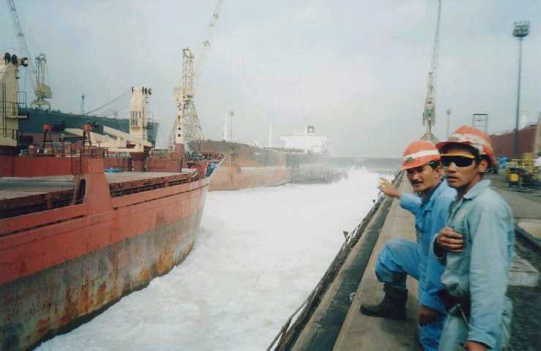

Slide 18
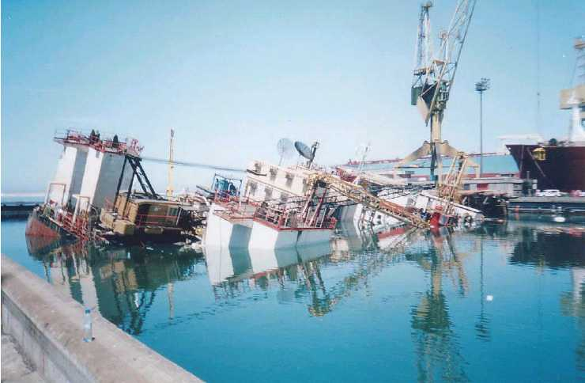

Slide 19
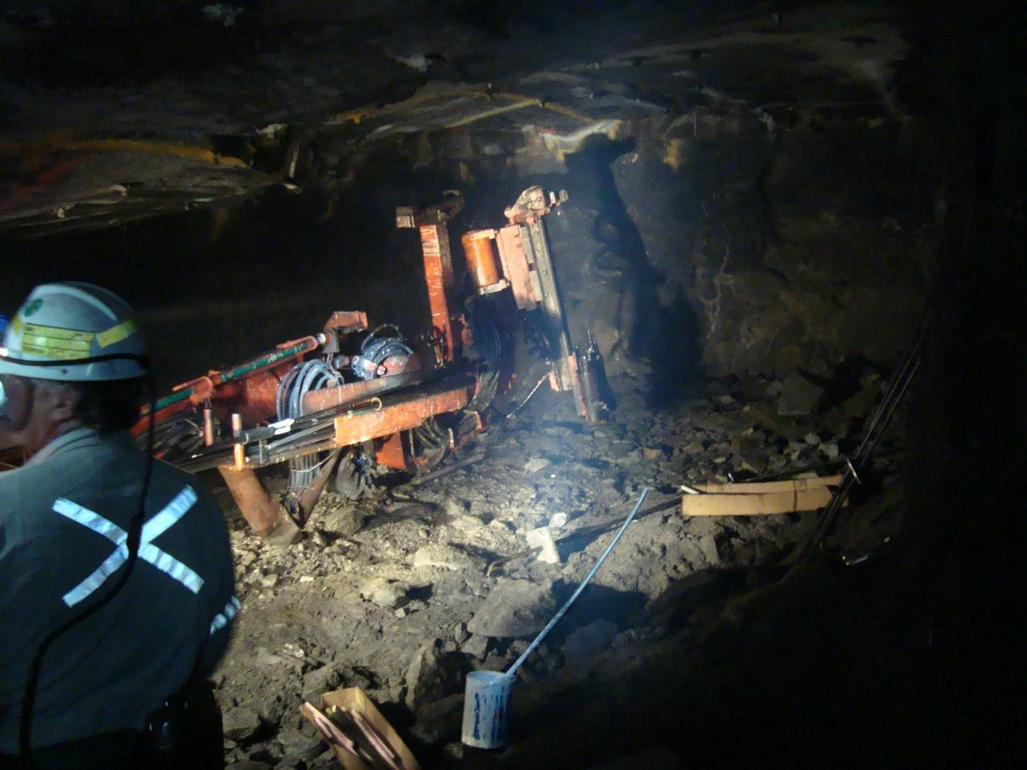

Slide 20
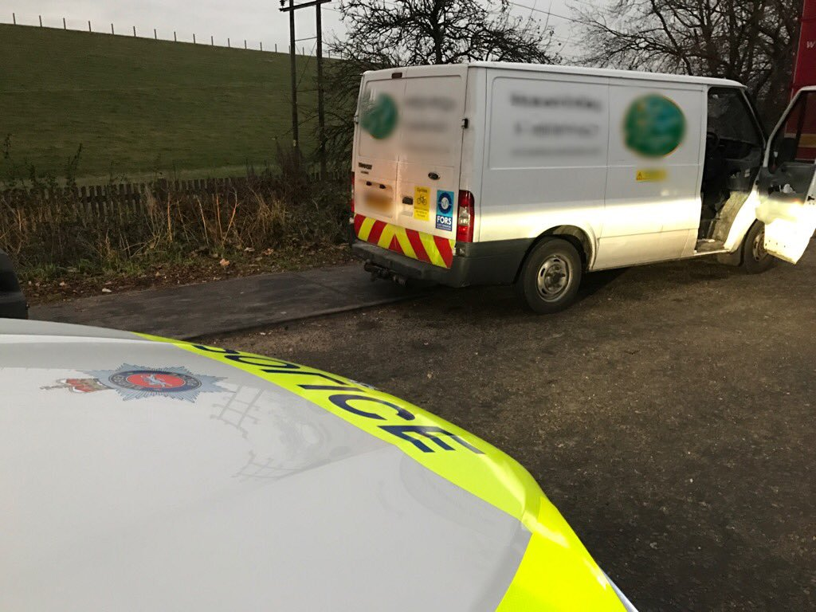

Slide 21
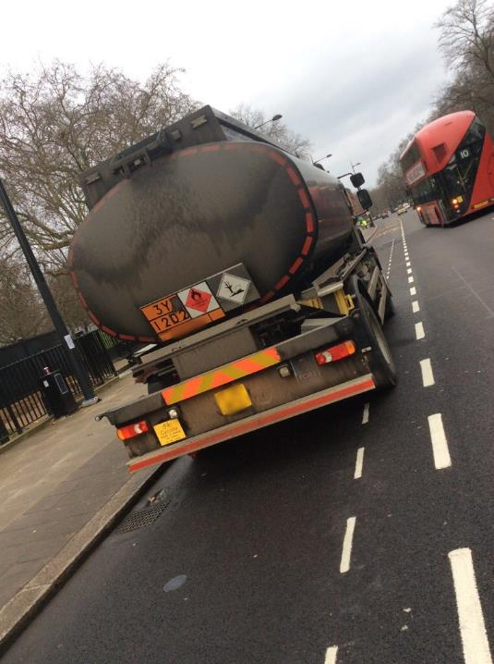
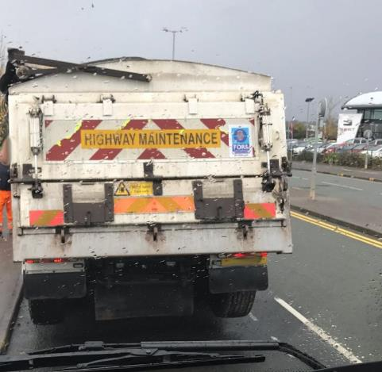

Slide 22
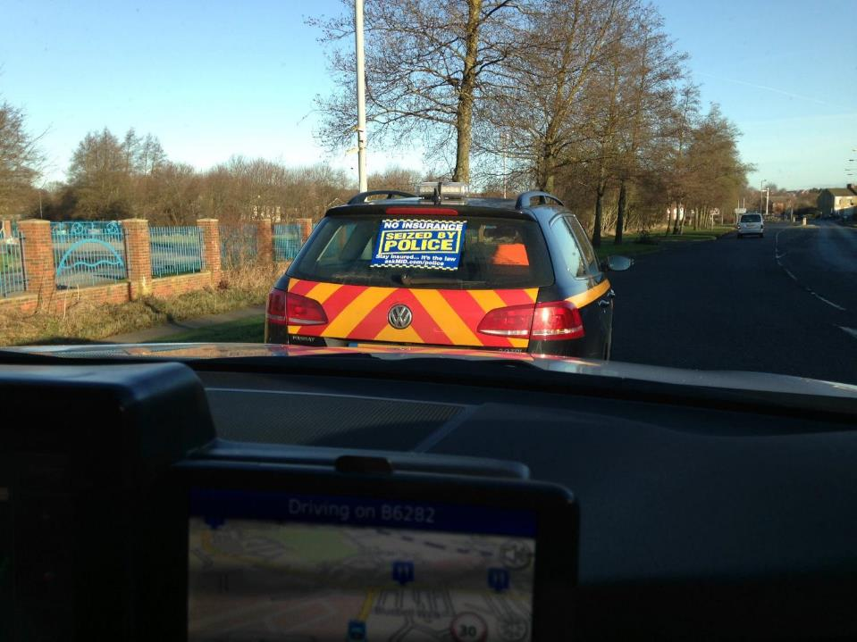

Slide 23
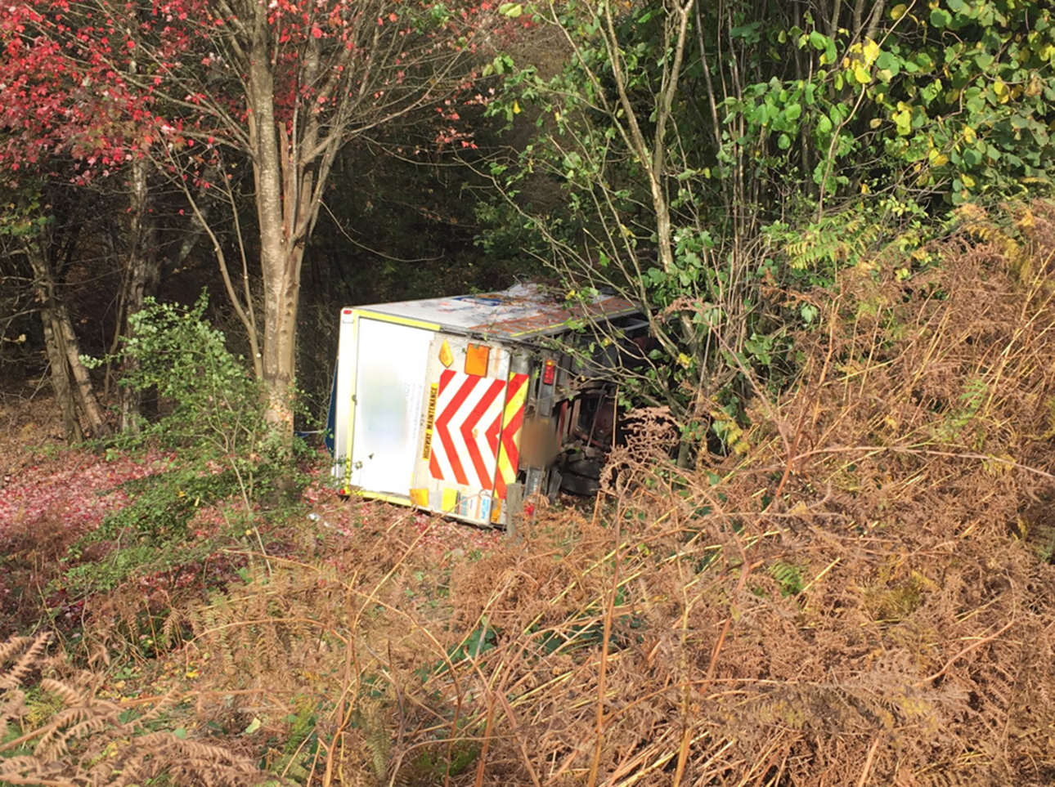

Slide 24
A commitment to safety should not be a priority, but a value that shapes decision making all the time, at every level.
(Tillerson, R., 2010)
saul.jeavons@transafenetwork.com
0207 112 7036

