Slide 1
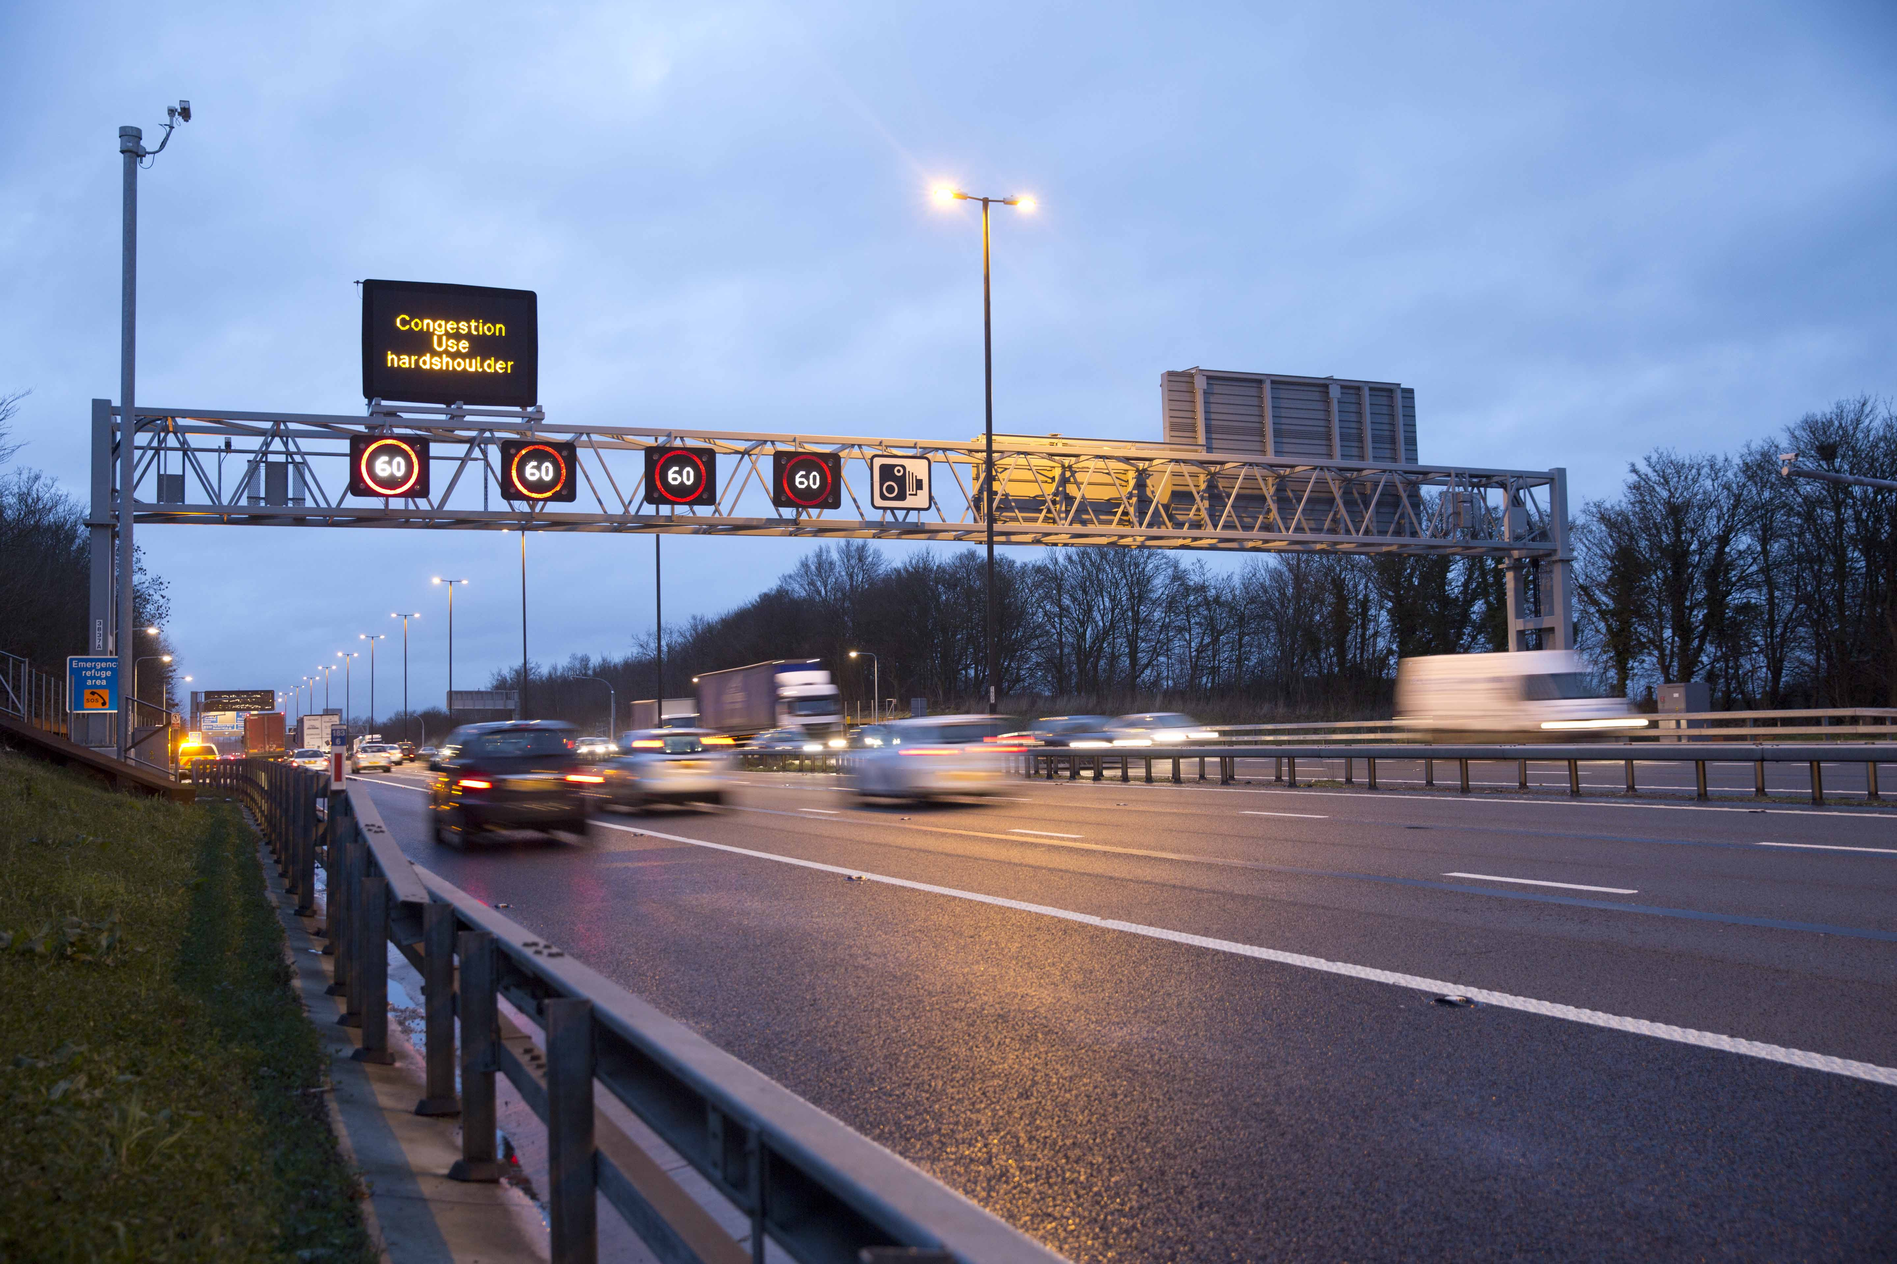
Safety Culture – Rail industry Dr Alastair Mckenzie-Kerr 14th March, 2017
Setting our people up to …….
The world’s leading sustainability consultancy
Notes:
Objective is to be deliberately provocative and if I achieve what I want them I hope to have convinced you all that:
It is not all doom and gloom in highways, there is a lot of good work, patches of great culture and operational performance, innovation and pride in delivery
There is a lot that can be learnt from other industries, prev speakers have raised this already.
What I want to do is share some of the points learned within mainline and underground rail administrations over the last however many years. I have picked the points that as an outsider, worknig in consultancy that we have seen drive the concerns, expenditure and action they have taken to improve the way they manage the performance of the people and the efforts to drive up behaviour.
From my POV rail provides perhaps the closest operating context to highways. The resource pool is shared, many of the companies in the supply chain are the same and the context within which work takes place (and I mean that broadly) is the closest fit.

Slide 2
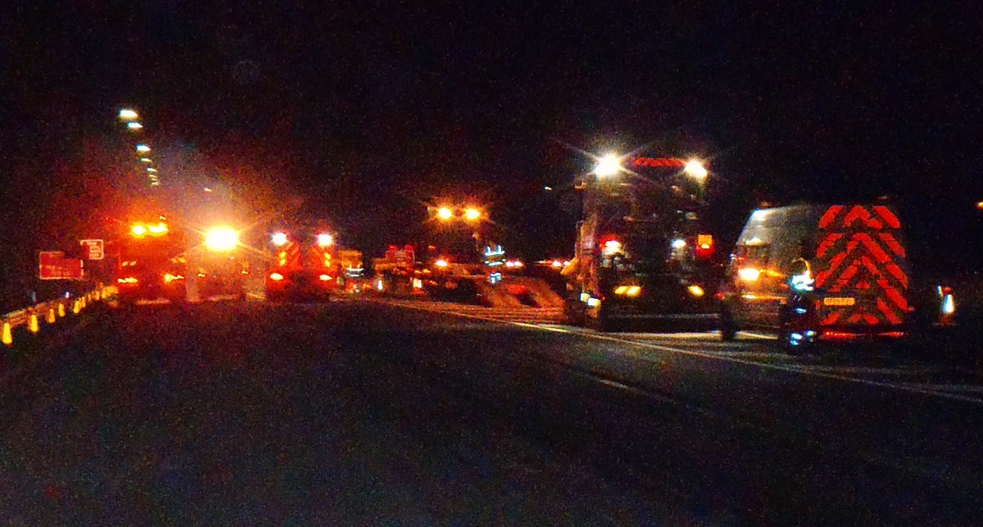
Background
Chartered Psychologist, Human Factors and Ergonomics specialists

Slide 3
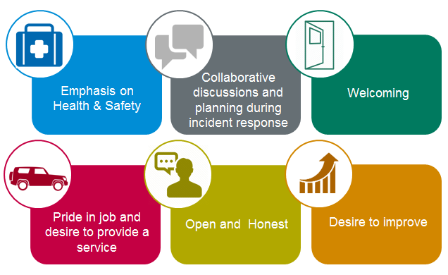
Baseline
It is not all bad news….

Slide 4
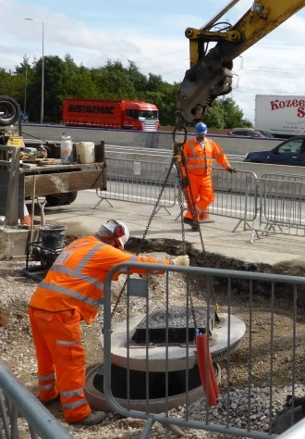
Last week, in a portacabin, near the motorway
“All these values and behaviours are great but what am I supposed to do with them?”
“You can forget all this touchy feely stuff, I’ve got a programme with no float and a target price that won’t be agreed until a month after we start digging.”
“There’s no value adding value to our resources”

Slide 5
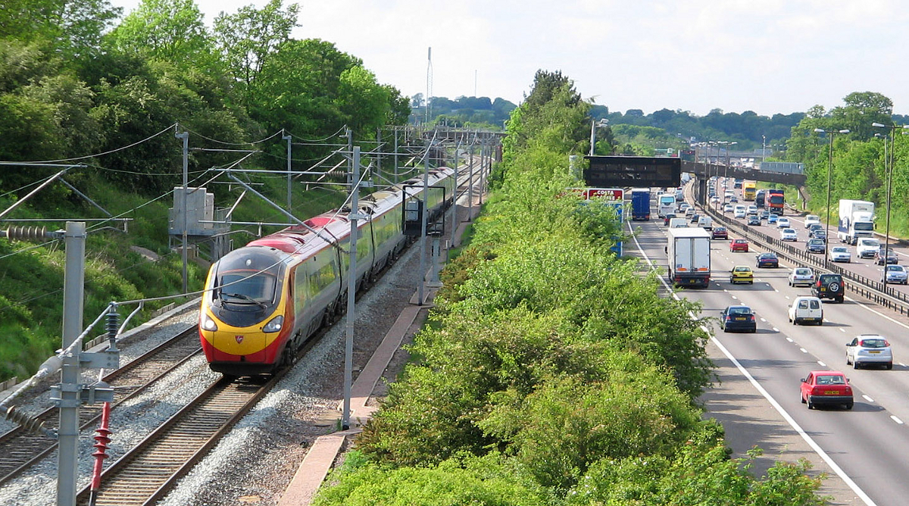
Parallels between road and rail
Supply chain
Workforce
Competence profile
Programme delivery and ops/maintenance
Client organisation
Regulatory environment
Geographical distribution of works

Slide 6
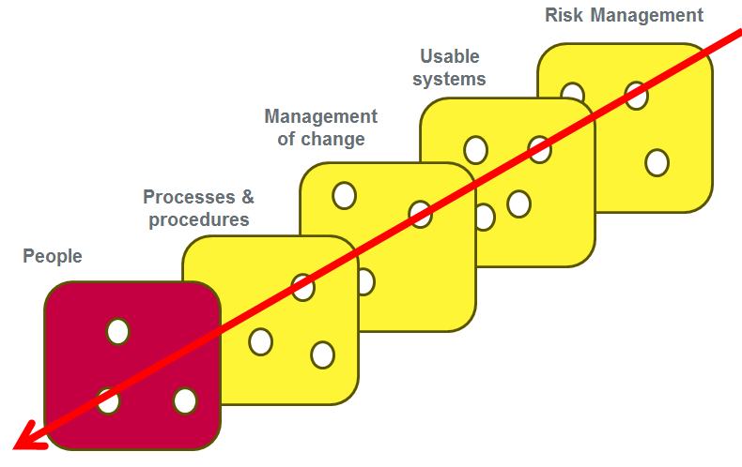
Key distinction…
Highways
Focus on the attitudes and beliefs that drive the desired behaviours
“Engineers looking for psychological solutions”
Rail
Focus on the attitudes and beliefs that drive the desired behaviours
Focus on how the organisation, plant, processes can be designed to ensure that the desired behaviours emerge
“Psychologists looking for engineering solutions”
Notes:
Key difference we see….
MESSAGE 1. In highways at the moment we define our safety culture by what people do…we look at bad behaviours and we focus on what we can do to change the attitudes and beliefs that are driving behaviour. We focus on the direct influences that will change the behaviour of the individual.
MESSAGE 2. In rail they are moving to a place where they can systematically design in the right behaviours, eliminate the potential for unsafe behaviours before they are even required, setting up working conditions plant and processes where people can succeed, despite the challenges they face.

Slide 7
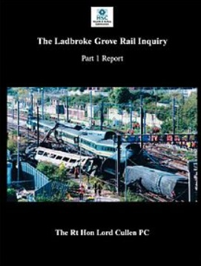
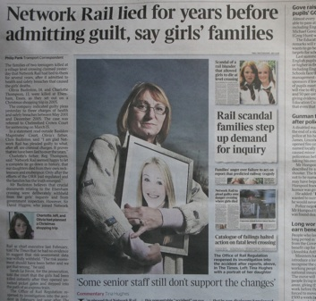
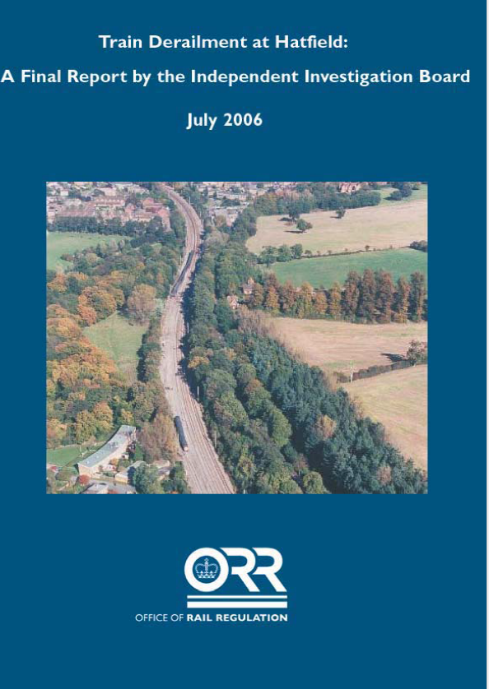
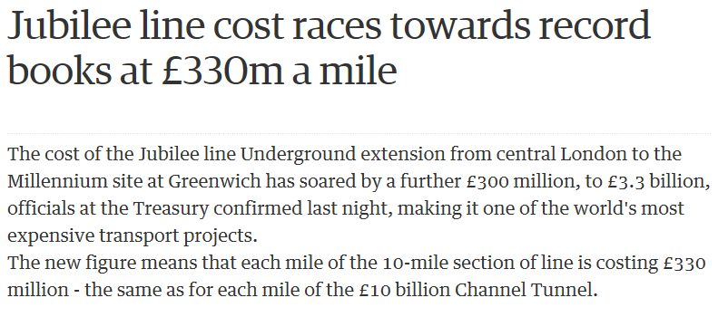
Drivers for change
Significant loss of life, injury in single events
Corporate manslaughter
Significant fines and regulator input
Significant cost overruns
Public and parliamentary inquiry
Significant media pressure
Notes:
Corporate manslaughter charges, significant fines, largescale media attention, even for events where fewer fatalities involved.
Following Cullen reports into Ladbroke Grove he said that the factors driving the performance of your people are not well understood by you and not well managed.
We haven’t had the same challenges and within highways the challenges are very different…but it has driven significant expenditure and investment in safety and safety culture through both Network Rail and London underground

Slide 8
Learning points
From what went well

Slide 9
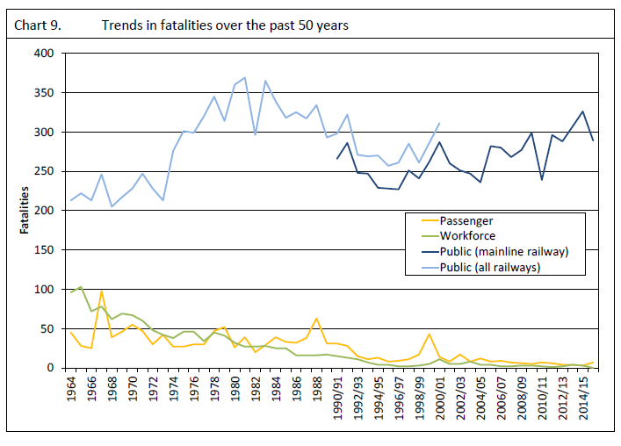
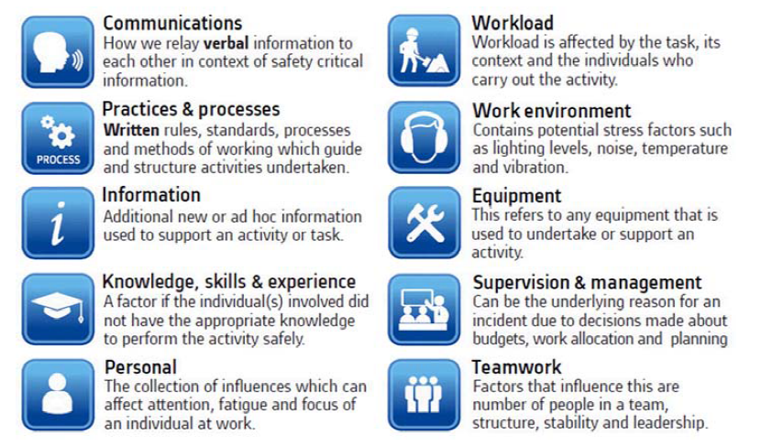
Learned from safety events
Strong evidence of improvements in safety performance
Causal and performance shaping factors
Notes:
Driving reporting of events through fair culture approach, independant close call reporting/CIRAS.
When events have happened they have looked for multiple causal factors, full range of incident and introduced classificaiton system to really systematically understand contributions to behaviour
Public – hasn’t changed much - rates of suicide, trespass and suspected suicide have remained comparable.

Slide 10
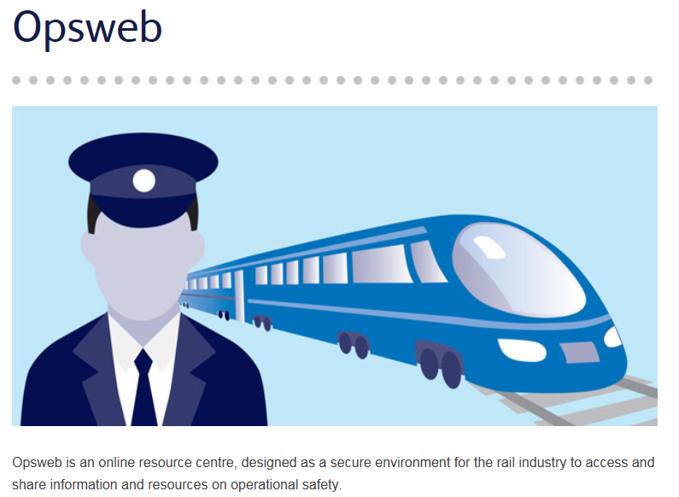
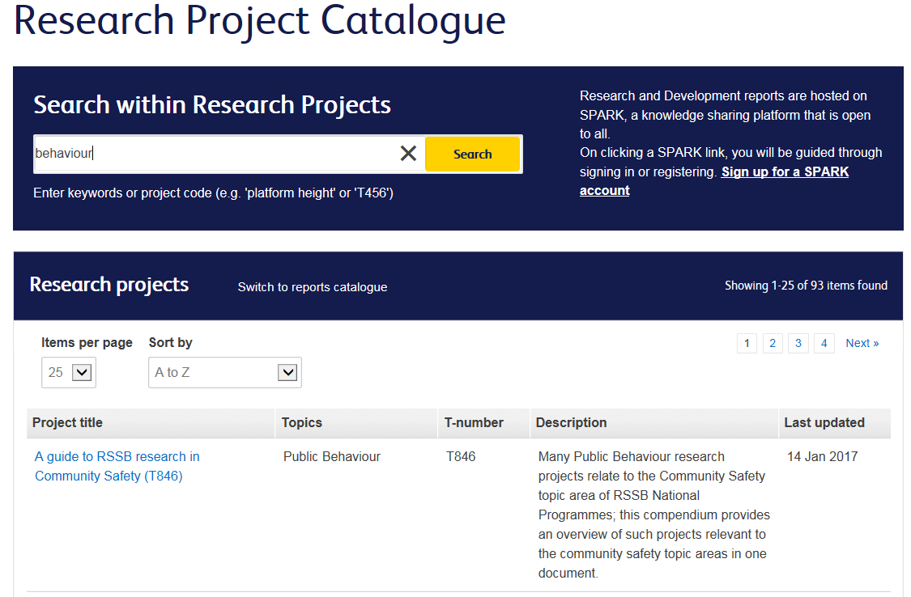
Co-ordinated research agenda
Notes:
Research management function representing interests of supply chain wide objectives.
Co-ordinated workstreams and formal inclusion of a range of stakeholders.
Channel for briefing of new research
Growing competence in research community
Focus on quality, Prog Managed research
Focus on outputs which solve difficult challenges requiring research, but provide practical outputs and immediate value.

Slide 11
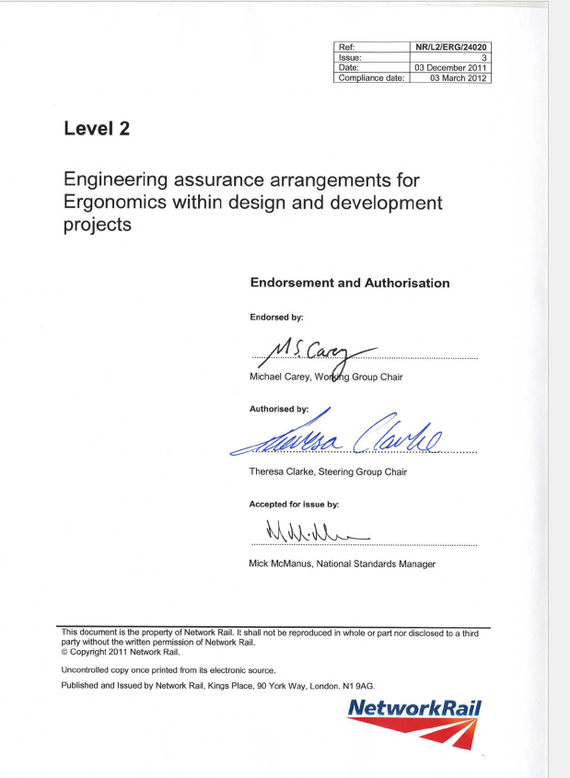
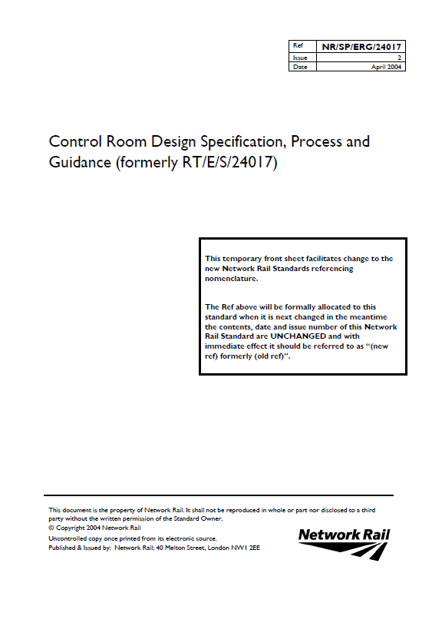
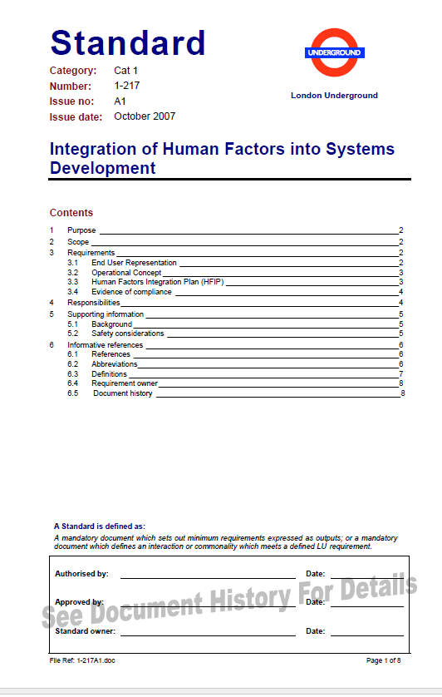
Embedded process
“We won’t do it unless our client asks and pays for us to do it”
11
Notes:
Both Network rail have teams with chartered HF and ergonomics professionals who sole remit it is to develop the research cannon around human performance, asking the right questions within
Both organisations follow a systems engineering approach to getting the right behavioural outcomes.

Slide 12
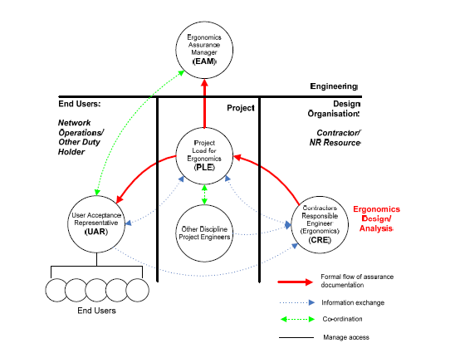
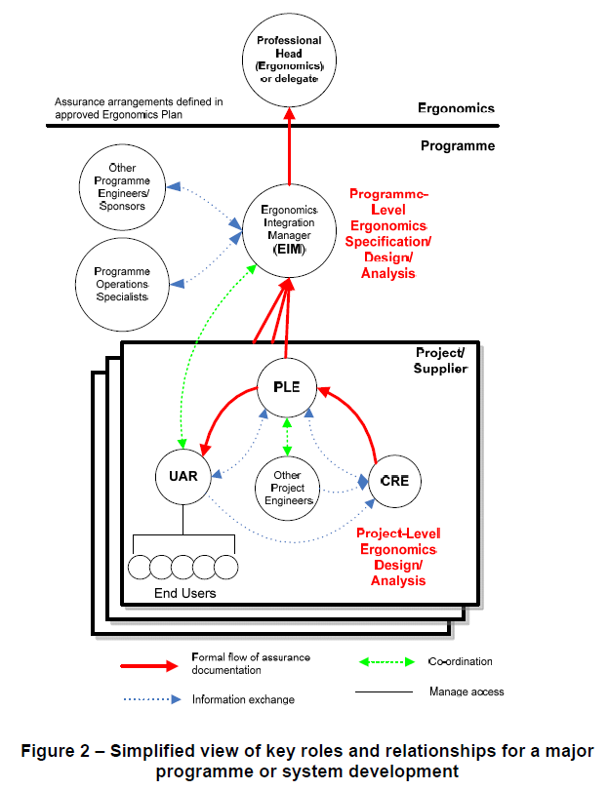
Embedded competence
Introduced circa 2000 following inquiry into Ladbroke Grove
Current team – 15, 25 at peak
75% major projects, 25% operational performance
Mixture of HF, Ergonomists, Safety Culture.
Introduced following high profile, significantly delayed line extension, around 2000
Current team – 11
Focus is on supporting projects
HF, Ergonomists embedded in project delivery teams.
12
Notes:
Both Network rail have teams with chartered HF and ergonomics professionals who sole remit it is to develop the research cannon around human performance, asking the right questions within
Both organisations follow a systems engineering approach to getting the right behavioural outcomes.

Slide 13
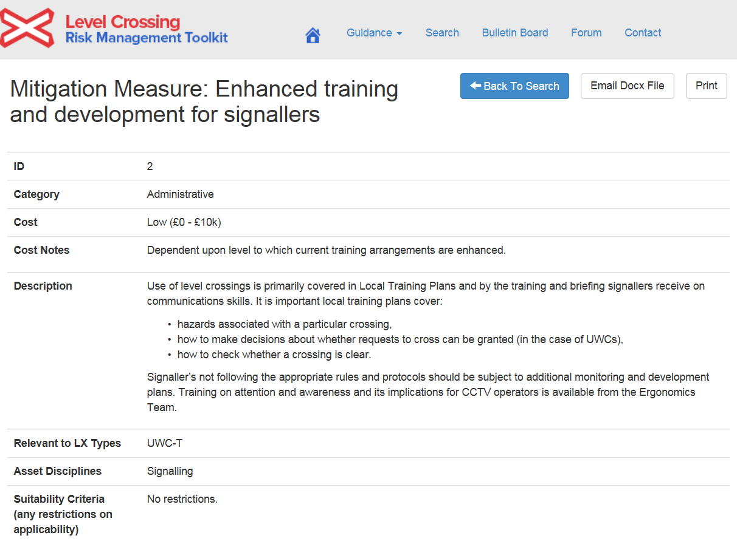
Calculating risk associated with behaviour
Tools, tools, tools:
ALCRM
Overcrowding risk assessment
Conspicuity Camera
Route Drivability Tool
SPAD Risk Ranking Tool
Fixed Lineside Assessment Tool
Taking Safe Decisions Analysis Tool
ODEC/IWA
Level Crossing Risk Management Toolkit
Notes:
These are all tools that can be used to ensure the right behavioural outcomes. Where weaknesses in human performance have been spotted previously or significant concerns
Standardise, share BP, turning research into solutions, accessible by/for all.
Provide tools to drive evidence-based, consistent decision making around

Slide 14
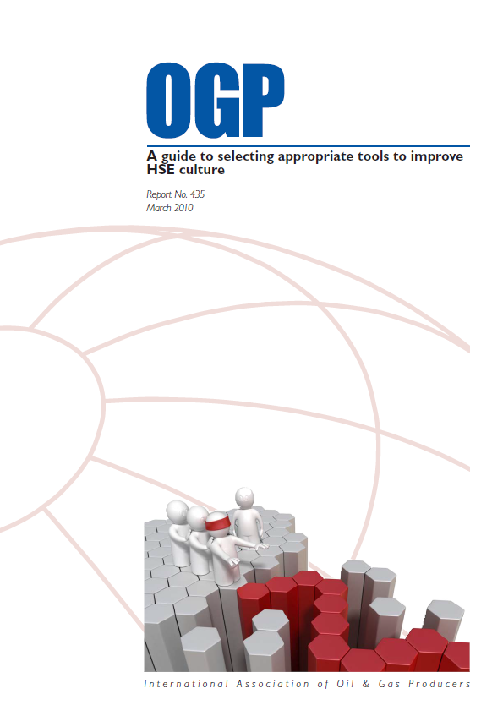
Embedding new tools
Tools will only deliver a culture improvement in the right conditions:
Just/fair culture:
“Now I know exactly when it is ok to blame someone”
Incident reporting system:
“Its great, but we haven’t had time to install the software on our new computers”

Slide 15
In summary
The baseline cultural foundations are good
Address behaviours by fixing the system not the individual.
Set people up to succeed, use engineering methods to design out the potential for undesirable behaviours.
Steps are underway…
Behavioural research programme
MP led Human Factors Integration programme and PTS collaborations
Systems thinking around safety and risk management.

Slide 16
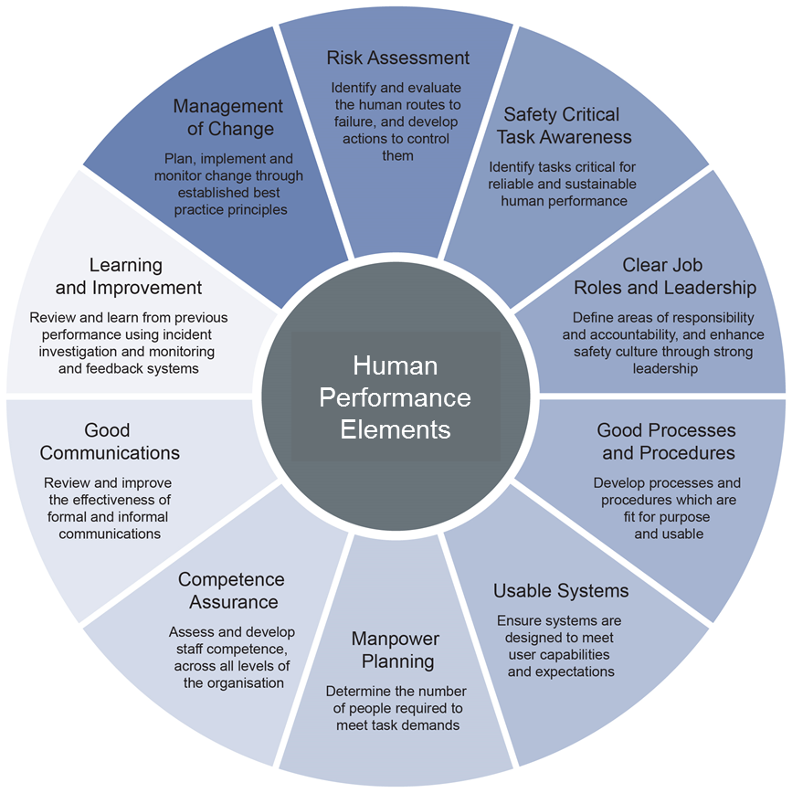
Thank you!
For more information please contact:
Dr Alastair Mckenzie-Kerr
Principal Consultant, Human Factors, ERM
T +44 117 910 6711
M +44 7887 411 226
E alastair.mckenzie-kerr@erm.com

