Slide 1
Making sense of behaviour: the COM-B framework
Robert West
Susan Michie
University College London
Centre for Behaviour Change

Slide 2
Outline
Developing behaviour change interventions
Developing ‘the concept’
The behavioural diagnosis: applying COM-B
Capability
Opportunity
Motivation
Behaviour

Slide 3
Developing behaviour change interventions

Slide 4
Concept
Knowledge
Goals
Opportunities
Development
Testing
Constraints
Activity map
Context
Stakeholders
Implementation
Abandonment
Collaborators
Promotion
Risks

Slide 5
Concept
Knowledge
Goals
Opportunities
Development
Testing
Constraints
Activity map
Context
Stakeholders
Implementation
Abandonment
Collaborators
Promotion
Risks

Slide 6
Developing the concept

Slide 7
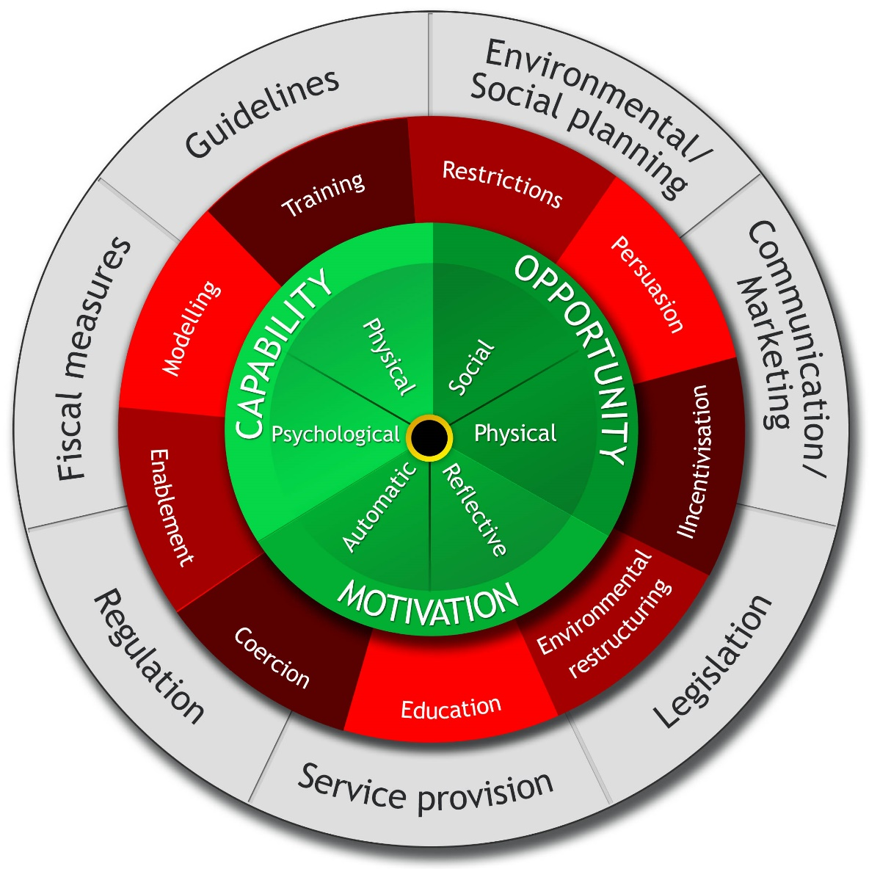
Steps in concept development
Step 1 | Specify the behavioural target
Step 2 | Identify what needs to change to achieve this
Step 3 | Identify intervention functions
Step 4 | Identify policies to achieve this
Step 5 | Identify behaviour change techniques
Step 6 | Flesh out the intervention

Slide 8
Steps in concept development
Step 1 | Specify the behavioural target
Step 2 | Identify what needs to change to achieve this
Step 3 | Identify intervention functions
Step 4 | Identify policies to achieve this
Step 5 | Identify behaviour change techniques
Step 6 | Flesh out the intervention

Slide 9
The behavioural diagnosis

Slide 10
For someone to enact a given behaviour at a given moment
s/he has to have the capability and opportunity and to be more motivated to enact the behaviour than other behaviours

Slide 11
Capability
Motivation
Behaviour
Opportunity

Slide 12
Capability, opportunity, motivation and behaviour form a dynamic interacting system
Each influences the other

Slide 13
Capability
Motivation
Behaviour
Opportunity

Slide 14
Capability

Slide 15
Physical and psychological capability
 | Physical | Psychological
Skills | e.g. steering control | e.g. hazard prediction ability
Strength | e.g. grip strength | e.g. self-control
Stamina | e.g. muscular endurance | e.g. resistance to tiredness
Structure | e.g. functioning visual system | e.g. functioning memory system

Slide 16
Opportunity

Slide 17
Physical and social opportunity
 | Physical | Social
Time | e.g. physical deadline | e.g. social deadline
Resources | e.g. available funds | e.g. peer support
Cues | e.g. environmental prompts | e.g. social triggers
Access | e.g. access to public transport | e.g. access to advice

Slide 18
Motivation

Slide 19
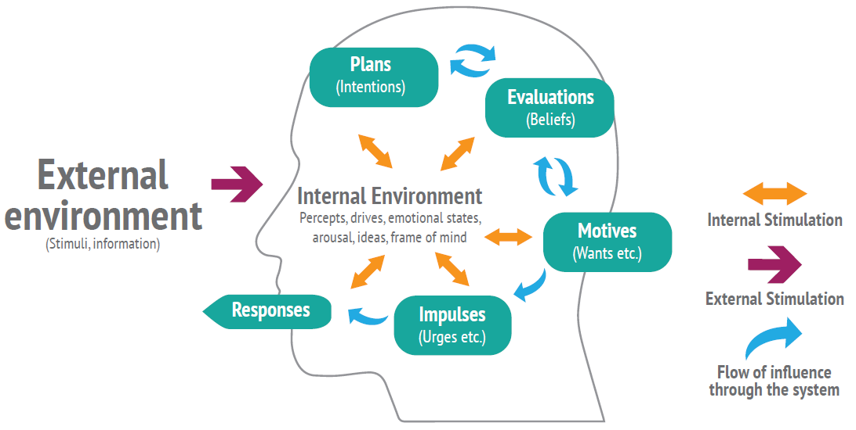

Slide 20
Behaviour

Slide 21
Facilitating and competing behaviour
 | Facilitating | Competing
Capability | e.g. practice | e.g. getting drunk
Opportunity | e.g. making time | e.g. displacement activity
Motivation | e.g. self-reward | e.g. displacement

Slide 22
Key points

Slide 23
For behaviour change interventions
Concept development requires a behavioural analysis
The COM-B model provides a way of structuring this analysis
This can guide the search of evidence to identify relevant intervention functions and ultimately the fleshed out intervention

Slide 24
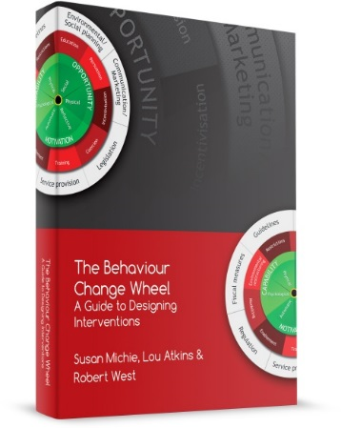
www.behaviourchangewheel.com/

