Slide 1
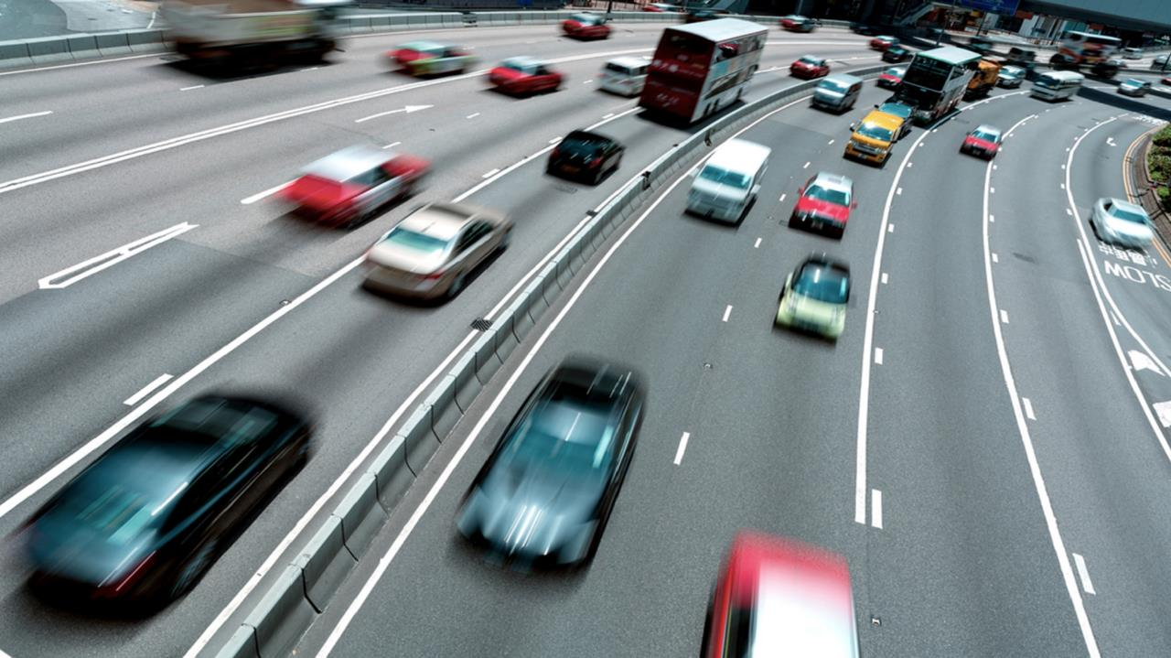
Road Safety Behaviour Symposium: New technology, new connectivity
Richard Cuerden
Chief Scientist & Research Director
14 March 2017

Slide 2
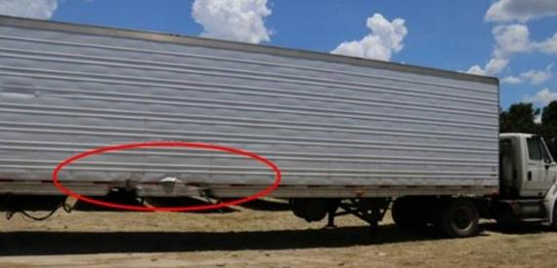
New technology, new connectivity
A changing world …..
The digital ‘revolution’
Internet, data and transport
Changing population characteristics
New mobility patterns, reduced individual vehicle ownership
Changing driver demographics
Ageing, obesity
Fewer young drivers
Changing vehicle fleet
Advanced safety technologies (ADAS)
Connected & Autonomous Vehicles (CAVs)
Safety, Efficiency, Environment, Mobility
Increasing diversity of vehicle types
More SUVs & light weight vehicles
More electric & hybrid vehicles
Intelligent Transport Systems (ITS)
Smart motorways
2

Slide 3
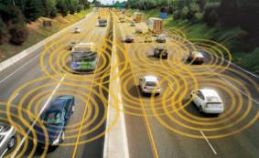
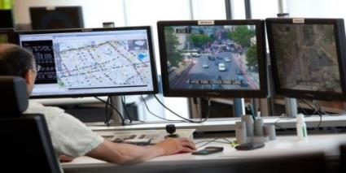
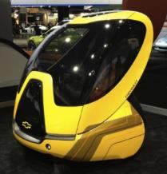
New technology, new connectivity
Traffic, modelling, control, communication and positioning systems
Auto-Traffic Counters
ANPR
cameras
TRL’s SCOOT
Mobile Phone “Counts”
In-vehicle data
“Apps”
Data fusion
Algorithms
Algorithms
Real-time detailed view of traffic behaviour on SRN network
Apps
ATC
SCOOT
“Safe Systems Transport Network” Data Integration & Connectivity

Slide 4
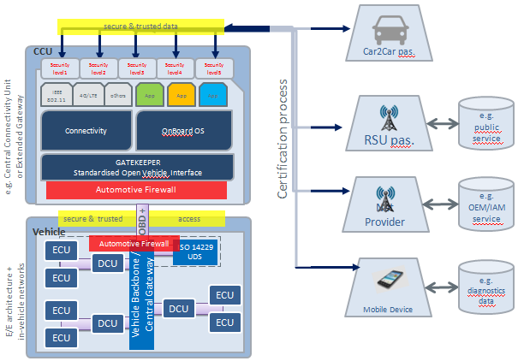
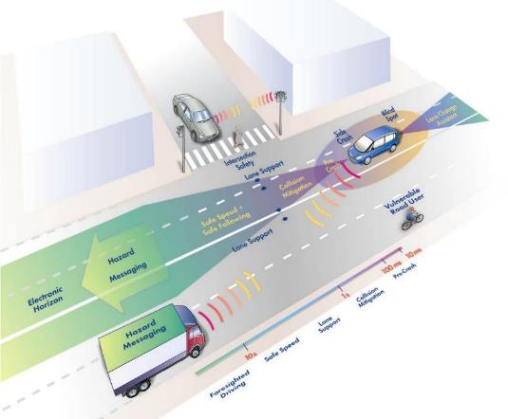
New technology, new connectivity
Intelligent Transport Systems
Technology to improve safety, efficiency, environmental performance and the journey experience for users.
In-Vehicle data
Data Server Platform
In-vehicle Interface
On-board Application Platform
4
Notes:
Key features of the Data Server Platform concept are that the data from the vehicle is sent to a back-end server where it can be made available. Therefore, both the data itself and the application using the data are outside the vehicle. Access to data using an In-vehicle interface is enabled via an upgraded interface inside the vehicle; any application using data would run outside the vehicle. Finally, the On-board Application Platform would allow access to data and the execution of applications inside the vehicle environment. WG6 also described three derivatives of the Data Server Platform: the Extended Vehicle, which proposed direct access to an ISO-standardised interface from the car manufacturers’ servers, the Shared Server, which proposed access from a server controlled by a consortium of stakeholders rather than the car manufacturer, and the B2B Marketplace, which proposed data held by an service provider for access by the market.

Slide 5
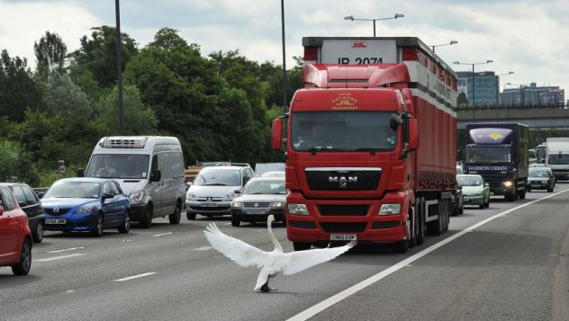
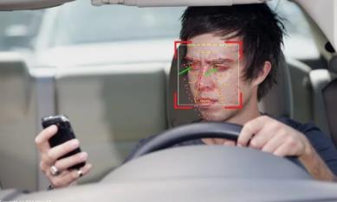
New technology, new connectivity
My recent experience …..
Warning: “Swan on road”
In- vehicle satnav system
Google Maps
Waze
INRX
+++
5

Slide 6
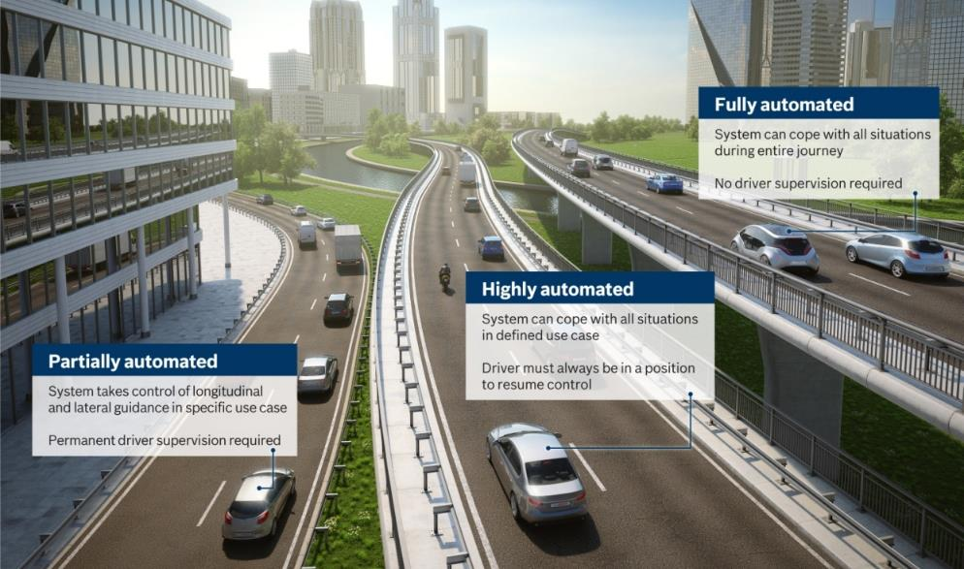
New technology, new connectivity
6

Slide 7
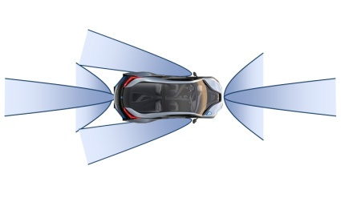
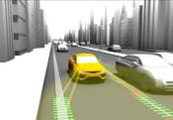
New technology, new connectivity
Today’s Driver Assistance Systems
Adaptive (Automated) Cruise Control (ACC)
Lane Keep Assistance (LKA)
Traffic Sign
Recognition (TSR)
Lane Change Assistance
Blind Spot Detection
Automated Parking
Rear Cross Traffic Alert
Automated Emergency Braking (AEB)
Traffic Jam Assist (TJA)
7

Slide 8
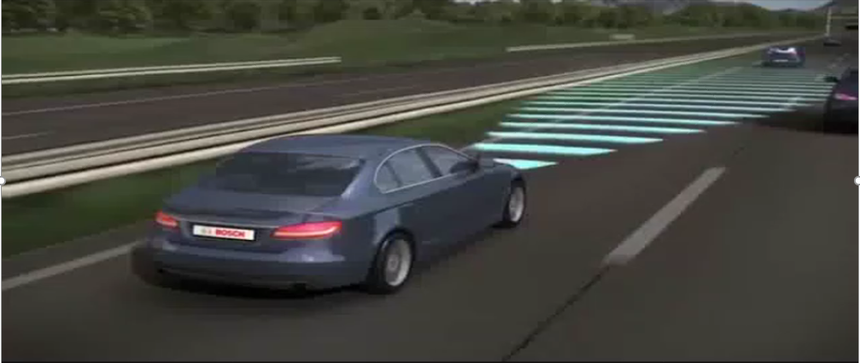
New technology, new connectivity
8

Slide 9
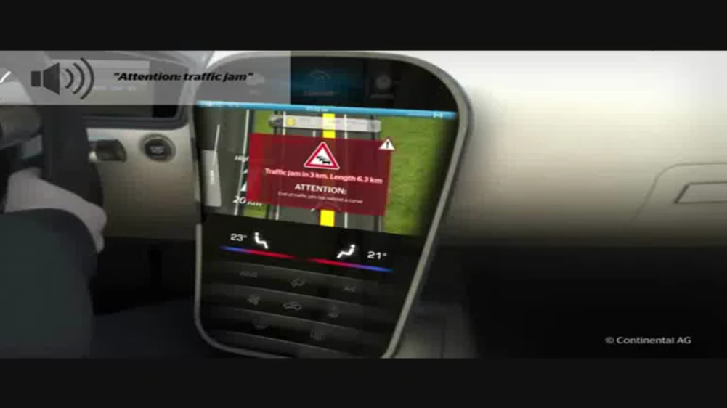
New technology, new connectivity
9

Slide 10
New technology, new connectivity
Full
Autonomy
Auto pilot
2020+
Highway
pilot
2020
Highway
assist 2018
Integrated
cruise assist 2017
Traffic Jam pilot
2019
Traffic jam assist 2015
Automated
Emergency Braking 2010
10

Slide 11
New technology, new connectivity
In 2016 Ford announced automated vehicle programme
2021
11

Slide 12
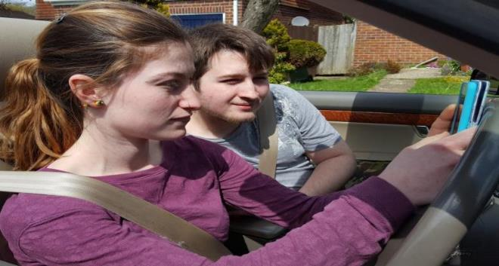
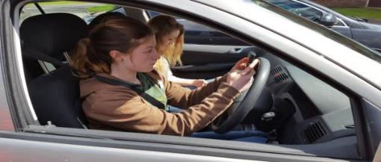
New technology, new connectivity
Is driving distracting when we want to be online?
Department for Transport set to allow drivers to text at the wheel
Most countries now permit the use of smart devices with ‘autopilot’ driving
DfT plans to allow the use of smart devices in automated vehicles
“Richard Cuerden’s creative media”
12

Slide 13
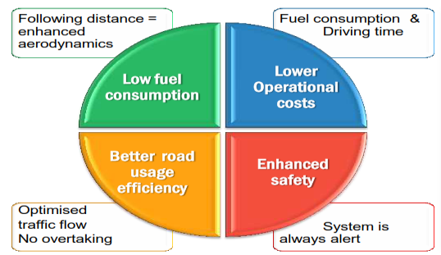
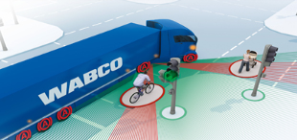
New technology, new connectivity
HGV Platooning trials
Pedestrian and pedal cyclist AEB

Slide 14
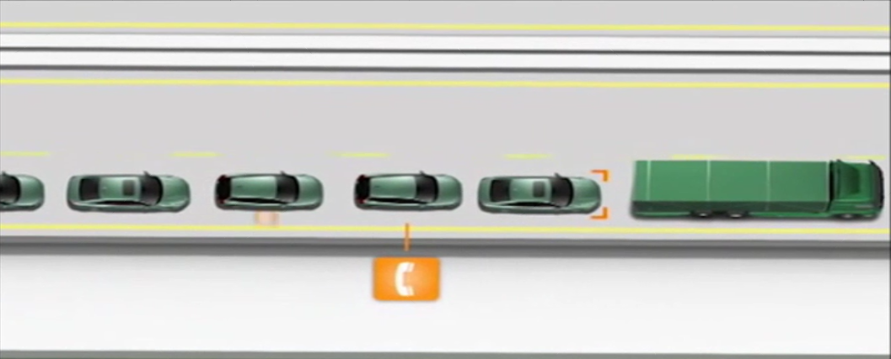
SARTRE
Notes:
Added music

Slide 15
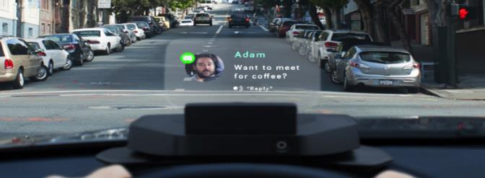
New technology, new connectivity
Other related technologies …..
//www.starship.xyz
//www.navdy.com

Slide 16
The new mobility revolution
Drivers for change
Introducing the UK Smart Mobility Living Lab
Greenwich, in Europe’s only mega city
Facilities and infrastructure
TRL as an independent facilitator
The opportunity
Shared Research Programme Collaborators

Slide 17
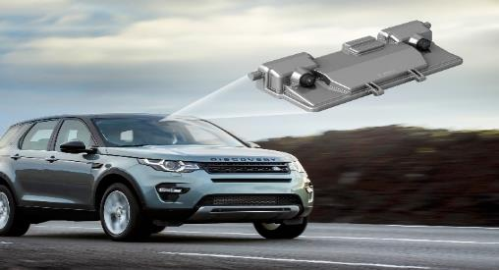
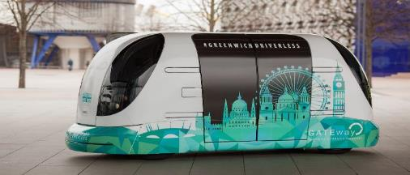
New technology, new connectivity
Conclusions
ITS and CAVs provide an opportunity to design mobility solutions to maximise public health and efficiency
But there are technological challenges, especially in urban environments and legal and regulatory hurdles
CAVs will start to be on our roads in ~ 3 years
New road user services and mobility solutions will affect our SRN
As a consequence our road transport health and safety priorities are changing
This is a mobility revolution! Remember, only 10 years since the iPhone
We need new methods to monitor and evaluate the network performance – to provide the evidence base for future policy and investment

Slide 18
Thank you Any questions?
Richard Cuerden
Chief Scientist & Research Director
Twitter: @rcuerden_trl
Email: rcuerden@trl.co.uk

Slide 19
Road Safety Behaviour Symposium: New technology, new connectivity

