Slide 1

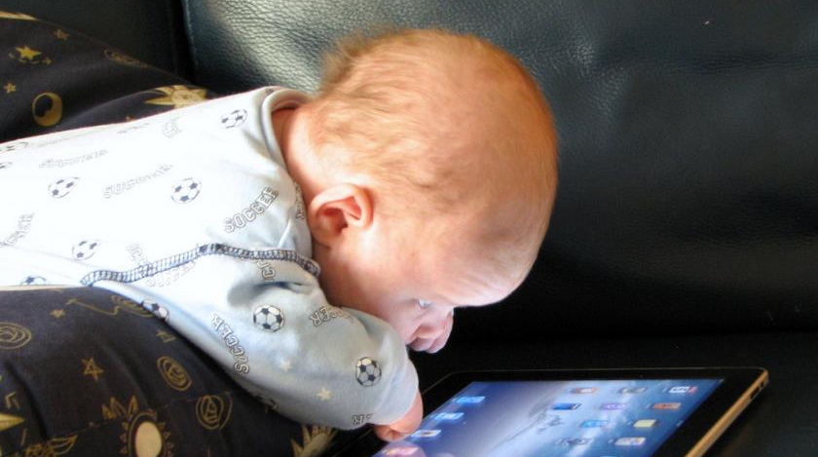
Trends in technology and society?
Highways England Road Safety Behaviour Symposium
Coombe Abbey, Warwickshire, 14-15 March 2016
Glenn Lyons,
UWE Bristol
Notes:
http://davidewart.typepad.com/.a/6a00d8345310da69e201a510db9c50970c-800wi

Slide 2
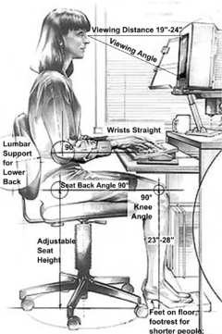
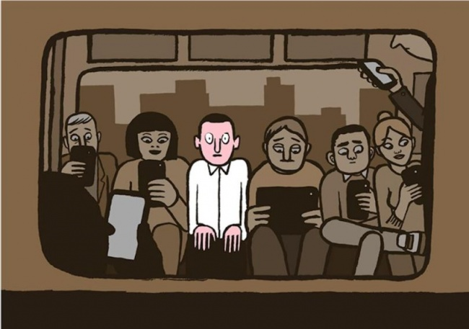
Human Factors and Societal Context
Notes:
https://upload.wikimedia.org/wikipedia/commons/thumb/c/c0/Computer_Workstation_Variables_cleanup.png/240px-Computer_Workstation_Variables_cleanup.png
http://www.mensxp.com/special-features/today/28549-20-honest-illustrations-of-modern-society-that-depict-the-irony-in-our-lives.html

Slide 3
Scenario Planning
How far out is far enough for safety and behavioural research purposes?
Homing in on uncertainties that matter

Slide 4
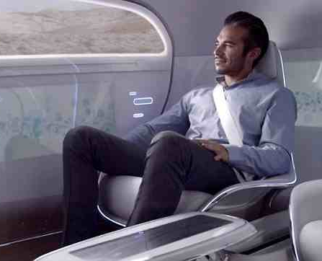

Driver-less
Futures
Vehicle occupancy levels?
Drive-less
Notes:
http://i.dailymail.co.uk/i/pix/2015/01/06/video-undefined-24733BBA00000578-584_638x362.jpg

Slide 5
Future uncertainties in the mix of…
drivers (age, experience, temperament)
vehicles (cars, vans, lorries, coaches)
vehicle control (manual, semi/fully autonomous)
familiarity with the vehicle (owned, shared, leased)
assistance and distraction

Slide 6
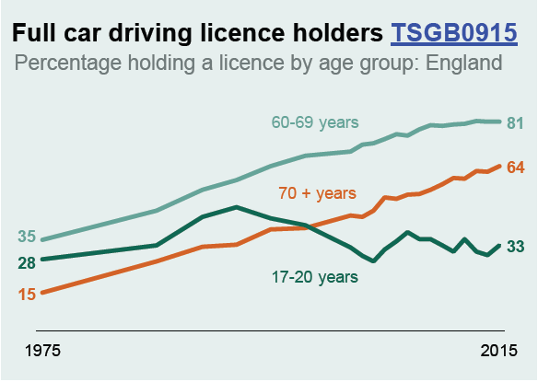
Mix of drivers
Postponed driving leading to safer driving?
Gender balancing?
Temperaments - carcooning as a blessing or curse in an always on society?
Transport Statistics Great Britain, 2016
Notes:
https://www.gov.uk/government/uploads/system/uploads/attachment_data/file/576113/tsgb-2016-print-ready-version.pdf

Slide 7
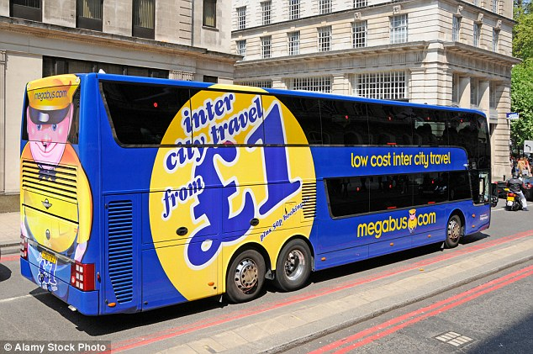
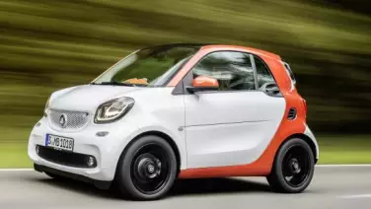
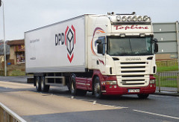
Mix of vehicles
"We have changed the cultural view of what bus travel used to be and we are tapping into a huge demand for budget inter-city travel.”
http://www.stagecoach.com/media/insight-features/the-growth-of-budget-travel.aspx
Peak ‘car culture’?
From driver to passenger
From status to efficiency
From go and buy to next day delivery
“the number of light commercial vehicles – LCVs or vans – has risen dramatically: up from 2.5 million in 2002 to 3.3 million in 2012”
http://www.racfoundation.org/assets/rac_foundation/content/downloadables/van_report_aecom_100414.pdf
Notes:
http://i.dailymail.co.uk/i/pix/2016/02/29/00/31A55EBD00000578-3467843-A_spokeswoman_for_Megabus_confirmed_that_it_had_assisted_police_-a-3_1456705119909.jpg
http://farm8.static.flickr.com/7513/15858103170_86a0b58ceb_m.jpg
http://www.lookers.co.uk/smart/new-offers/

Slide 8
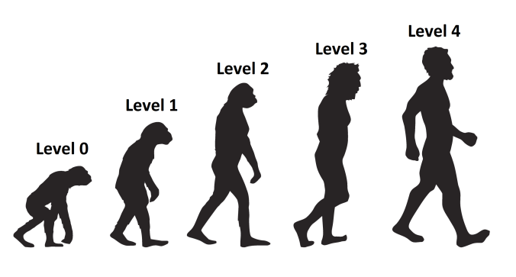
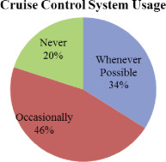
Mix of vehicle control
Technology readiness?
Technology adoption?
Technology use?
Technology timescales?
“Survey on In-vehicle Technology Use: Results and Findings”
http://www.sciencedirect.com/science/article/pii/S2046043016300648
Notes:
https://spencersfourcorners.files.wordpress.com/2016/01/evolution-of-the-car.png?w=676

Slide 9
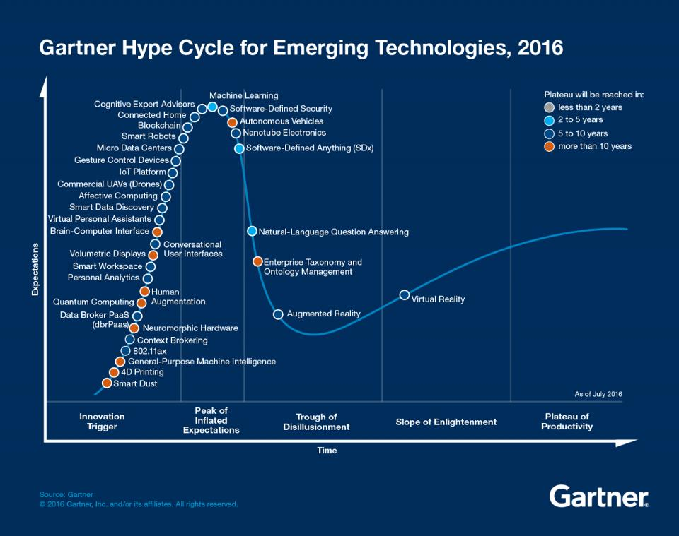
Beware the hype
Notes:
gartner.com/SmarterWithGartner

Slide 10
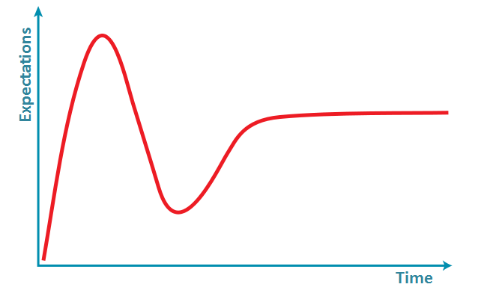
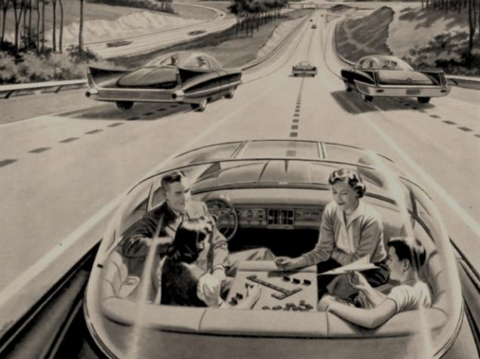

Autonomous vehicles
Peak of market noise
Autonomous vehicles
(5-10 years to plateau)
2015
2010
2016
Autonomous vehicles
(>10 years to plateau)
2014
2012
Augmented reality
2010
2016
“some things fall out of the trough and never make it”
Betsy Burton, Gartner, 2016
Notes:
https://i.ytimg.com/vi/I5etgklCrBc/hqdefault.jpg
Advertisement from 1957 for “America’s Independent Electric Light and Power Companies” art by H. Miller

Slide 11
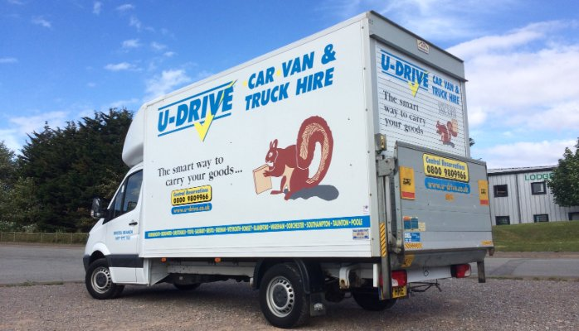
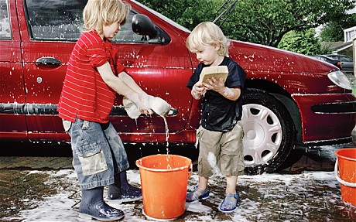
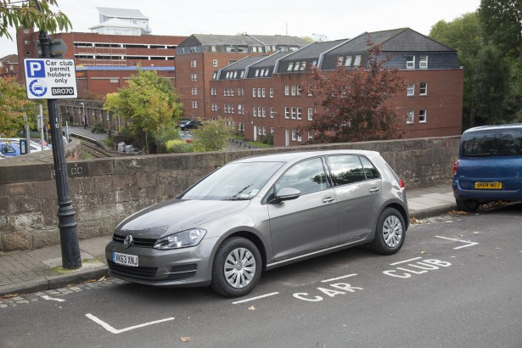
Mix of familiarity with the vehicle
Transitioning from traditional models of vehicle ownership
How does this affect driver behaviour?
Notes:
https://media.licdn.com/mpr/mpr/AAEAAQAAAAAAAAKGAAAAJDYwOGNmYzRmLWI3MDUtNDRlZi1iMjBjLWE1MTAwY2Y4ZTJhZA.jpg
https://www.carplus.org.uk/what-is-shared-mobility/car-sharing-clubs/
http://www.blogwithmom.com/wp-content/uploads/2015/03/wash_1901265c.jpg

Slide 12
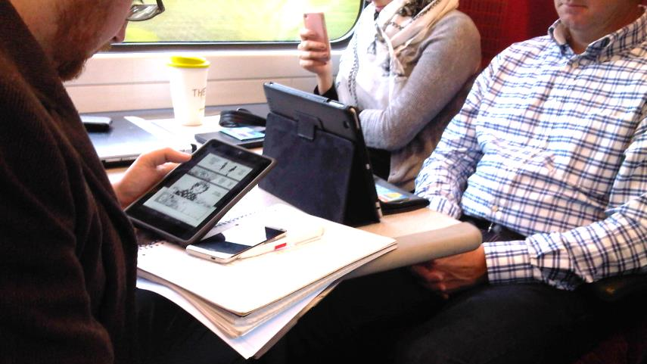
Mobility as an Activity (MaaA)
Travel efforts:
physical, cognitive, affective

Slide 13
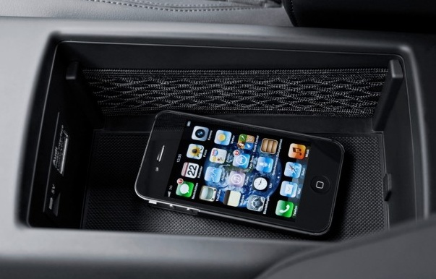
Mix of assistance and distraction
Travel time versus activity time support
Technologies competing for attention
Autopilot versus anti-activity
Notes:
http://telematicsnews.info/2012/05/22/in-car-smartphone-usage-enhancement-box-developed-by-plds-funkwerk_my3221/

Slide 14
Glenn.Lyons@uwe.ac.uk

