Slide 1




A systems-based approach to young driver road safety
Highways England Road Safety Behaviour Symposium 2017
Dr Neale Kinnear

Slide 2
Overview
Who?
Who is at risk?
Why?
Why do we need a systems-based approach?
What?
What is a systems-based approach?

Slide 3
Who is at risk?
Age v Experience
70%
Maycock et al (1991)
Notes:
Based on DVSA data from 2011, around 70% of all people in GB attempting driving tests are 17-24. Around 53% are 17-19.

Slide 4
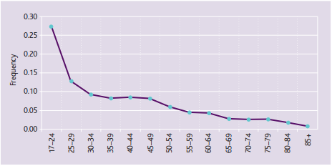

Catastrophic claims
Proportion of catastrophic claims by age
Source: ABI (2012) https://www.abi.org.uk/~/media/Files/Documents/Publications/Public/Migrated/Motor/Improving%20the%20safety%20of%20young%20drivers.ashx
Notes:
Based on DVSA data from 2011, around 70% of all people in GB attempting driving tests are 17-24. Around 53% are 17-19.

Slide 5
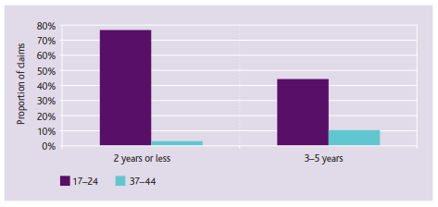
Catastrophic claims
Proportion of catastrophic claims by years of driving experience,
17–24 year olds and 37–44 year olds
Source: ABI (2012) https://www.abi.org.uk/~/media/Files/Documents/Publications/Public/Migrated/Motor/Improving%20the%20safety%20of%20young%20drivers.ashx
Notes:
17–24 year olds with 2 years or less driving experience are much more likely to make a catastrophic claim than 37–44 year old drivers with the same driving experience.
This clearly demonstrates that it is the age of the driver – not necessarily just their experience – that is the key factor impacting upon the likelihood of suffering a catastrophic injury in a crash.

Slide 6
Influences on young and novice driver crash risk
Lack of experience
Poor Hazard Perception
Gender
NOVICE DRIVER CRASH RISK
Age related factors
Brain development
Over-confidence in abilities
Expression
Thrill seeking
Lifestyle and social attitudes
Alcohol and Drugs
Peer influences
Parents
YOUNG NOVICE DRIVER CRASH RISK
Notes:
6

Slide 7
Risk mitigation
 | Overarching risk | Mitigation approach in GB
1 | Novelty seeking | Education
2 | Risk taking | Education / New Drivers Act
3 | Independent peer-based social interaction | Education
4 | Exposure to unfamiliar traffic situations | Education / Training
Notes:
Around 10% of novice drivers are caught for committing an offence within the two-year probationary period after passing their first practical driving test. Around 2% of novice drivers have their licences revoked under the Act.
The implementation of the Act was associated with a reduction in the proportion of drivers with two or more offences, a reduction in the number of offences overall and a substantial reduction in the proportion of new drivers with six or more points since the introduction of the Act. This suggests that the Act has therefore had a beneficial effect on offending patterns.

Slide 8
Evidence for effectiveness
“According to the evidence it [education and training] has no measurable direct effect on collision risk, and its continued use should therefore be set against much lower expectations in terms of what it can contribute directly to the safety of new drivers.”
(Helman, Grayson & Parkes. 2010, p 8)
“The evidence base for education and training is weak at best, and effectively non-existent when collisions and injuries are used as the outcome of interest”
(Kinnear et al., 2013, p iv)
Based on synthesis of numerous meta-analyses and systematic review papers (Brown et al., 1987; Christie, 2001; Clinton & Lonero, 2006; Mayhew et al., 1998, 2002; Roberts & Kwan, 2001; Vernick et al., 1999)
Notes:
Reasons:
Inappropriate foundation for the intervention
Information deficit model
Dosage
Risk as a value
Social norms
Exposure to risk
Economic climate
Realistic outcomes
Based on McKenna (2010)

Slide 9
Why are interventions not effective
Neurological development
Poor design and evaluation
Overall approach is ‘young-driver centric’

Slide 10
Taking a wider perspective
Young drivers in a broader context
Health and wellbeing
Healthy eating
Alcohol
Drugs
Sexual health
Mental health
Lifestyle choices
Enhancing life skills
Decision making
Exploring alternatives
Assertiveness (saying ‘no’)
Effective communication
Responsibility
Self-management

Slide 11
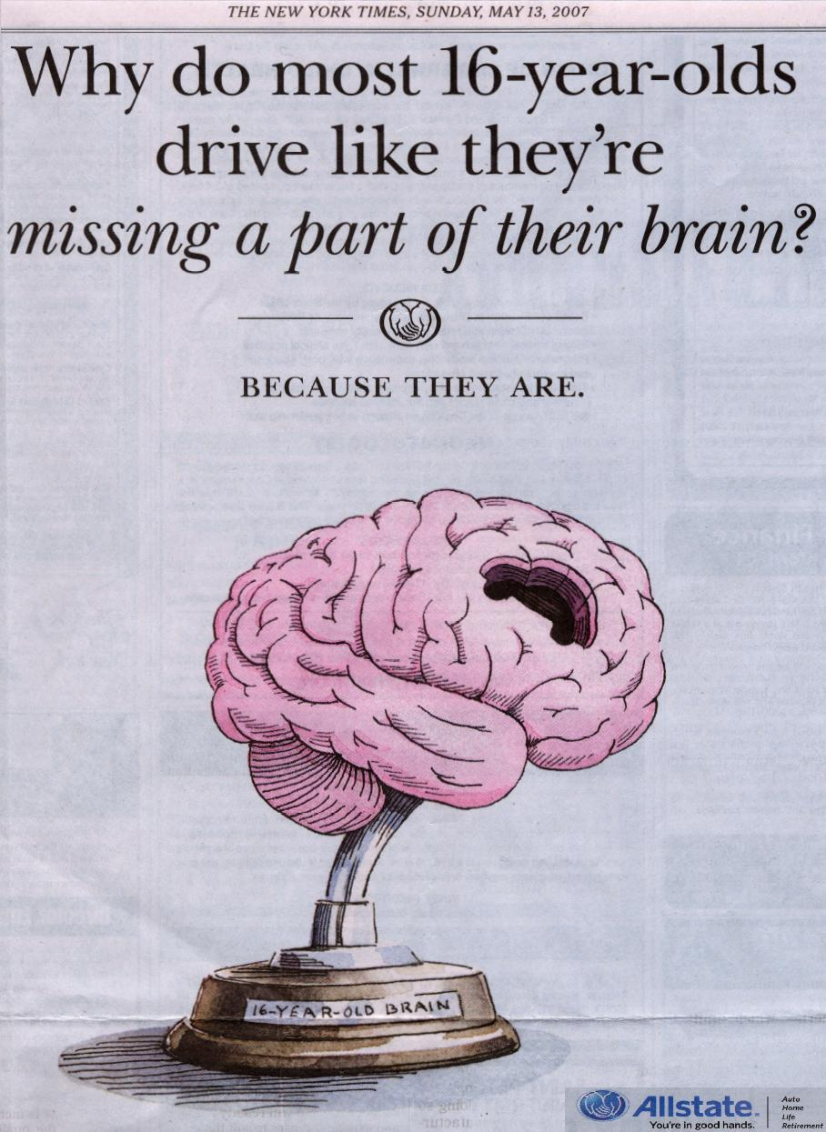
Brain development
Adolescent risk behaviour traced to structural changes in brain development (Boyer, 2006; Glendon & Bryan, 2011)
Neurological mapping of the driving task explored using fMRI (Calhoun et al., 2002; Graydon et al., 2004; Horikawa et al., 2005; Spiers & Maguire, 2007; Uchiyama et al., 2003; Walter et al., 2001)

Slide 12
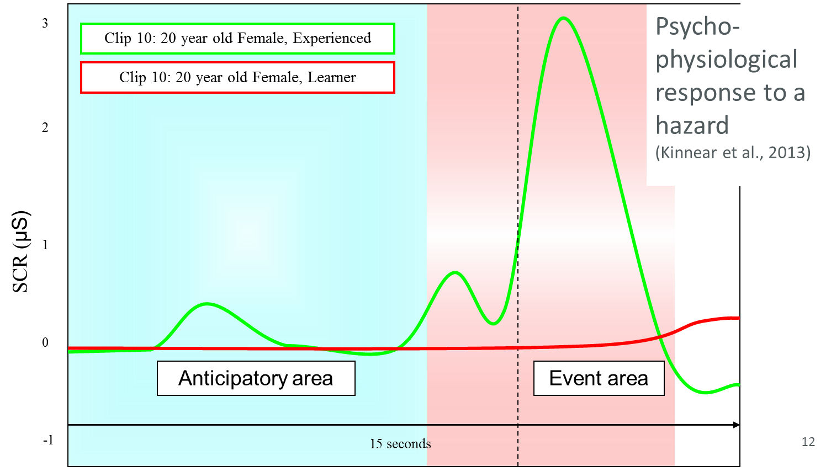

Slide 13
Why are interventions not effective?
Brain development
Poor design and evaluation
Overall approach is ‘young-driver centric’

Slide 14
The current approach
Theory, HP, Practical tests
New Driver’s Act
Child Teen Pre-driver
Novice Experienced
Birth
17
+1 year /1000 miles
>3 years
Education
Notes:
Research commissioned by DfT examined current pre-driver education in the UK (Launchbury et al., 2007). The majority of areas in the UK provide some form of pre-driver education. Most common aims:
To reduce collisions among young novice drivers
To influence attitudes towards driving
To prepare young people for starting to drive or early licensure
To raise the awareness of the risks associated with driving

Slide 15
What if…
Interventions were not expected to improve safety directly
They were designed appropriately with realistic aims
They were evaluated against realistic aims and could be justified
Notes:
Education should be used to support and complement safety measures known to be effective (e.g. legislation and enforcement, policy, parental/community education, associated public health measures)
Outcomes and learning objectives should be defined and realistic

Slide 16
Why are interventions not effective?
Brain development
Poor design and evaluation
Overall approach is ‘young-driver centric’

Slide 17
What a system-based approach is not
It is not safe-systems or safety culture!
Safe-systems philosophy:
  People will make mistakes and roads, vehicles and speeds should be designed to reduce the risk of a crash and protect people in the event of a crash
Traffic Safety Culture:
  “The assembly of underlying assumptions, beliefs, values and attitudes shared by members of a community, which interact with the community’s structures and systems to influence road safety related behaviours.” (Edwards et al., 2014)

Slide 18
What a system-based approach is
Crashes are the outcome of interactions between multiple components in a complex sociotechnical system
Systems thinking aims to understand how different components of complex systems interact
It is argued that a ‘systems based approach’ rather than a driver-centric approach is required to improve the safety of young novice drivers (Scott-Parker et al., 2015; Twisk et al., 2015)

Slide 19
What is ‘the system’?
Developed from Rasmussen’s (1997) Risk Management Framework
Level | Domain | Example factors
1 | Government policy | Legislative decisions and actions
2 | Regulatory bodies and assocs. | Implementation of legislation and requirements
3 | Proximal authorities | Local authority responsibilities / Parents
4 | Other influences | Influential others
5 | Immediate actors | Young drivers
6 | Environment and equipment | The physical environment and the vehicles

Slide 20
The Actors
Government policy | DfT | Courts
Regulatory bodies and assocs. | Highways England | DVSA | PACTS | RACF, AA, IAM etc. | Vehicle manufacturers | Insurance | Research organisa-tions | News/ media
Proximal authorities | Local authorities | Parents
Other influences | Other family | Peers | Educational institutions | Employers | Vehicle manufacturers | Communi-cations developers | Community groups | Entertainment venues (e.g. pubs/clubs) | Social media
Immediate actors | Young drivers | Young passengers | Other passengers | Other road users
Environment and equipment | Vehicles | Infrastructure
Adapted from Scott-Parker et al. (2015)

Slide 21
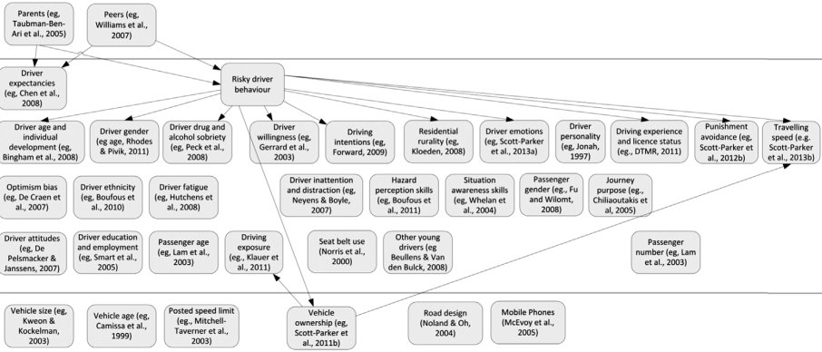
The Research
Government policy | Licensing
Regulatory bodies and assocs. | Improvem-ents to the driving test | Reviews | Analysis of contributory factors
Proximal authorities
Other influences
Immediate actors
Environment and equipment
Adapted from Scott-Parker et al. (2015)

Slide 22
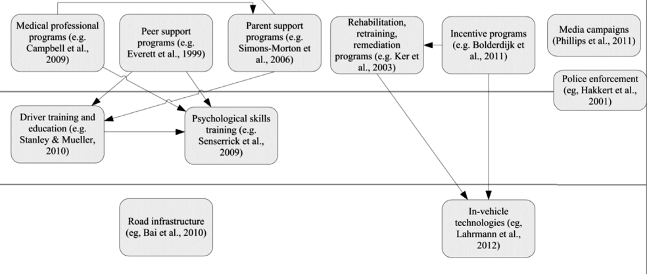
The Interventions
Government policy | New Drivers Act | Changes to penalties
Regulatory bodies and assocs. | Improvem-ents to the driving test
Proximal authorities
Other influences
Immediate actors
Environment and equipment
Adapted from Scott-Parker et al. (2015)

Slide 23
Example
Young people socialise late at night
Limited public transport makes driving desirable
The support from all parts of the ‘system’ will determine effectiveness (e.g. education can be used to support)
Current approach | Systems-based approach
Inform young people about the risks of driving at night and consequences of a crash | Legislative night time protection for new drivers (e.g. USA, Australia, NZ)
 | Free travel on public transport for young people (e.g. The Netherlands)

Slide 24
Summary
Young novice drivers are a high-risk group
The current approach to mitigating risk relies heavily on education
The evidence for this is weak/non-existent
It is important that we appreciate the wider context and limitations of youth
Interventions could and should be realistically positioned as part of a supportive framework
Focus to date has been on understanding why they crash, and trying to fix them
Little attention to how the ‘system’ affects risk

Slide 25
“every system is perfectly designed to achieve exactly the results it gets”
(Berwick, 2003, p449)

Slide 26
So…
Can we develop a systems-based framework to improve the safety of young novice drivers and provide a valued and realistic role for educational interventions?

Slide 27
Thank you
Presented by Dr Neale Kinnear
Principal Psychologist
March 2017
Tel: +44 1344 770101
Email: nkinnear@trl.co.uk

Slide 28
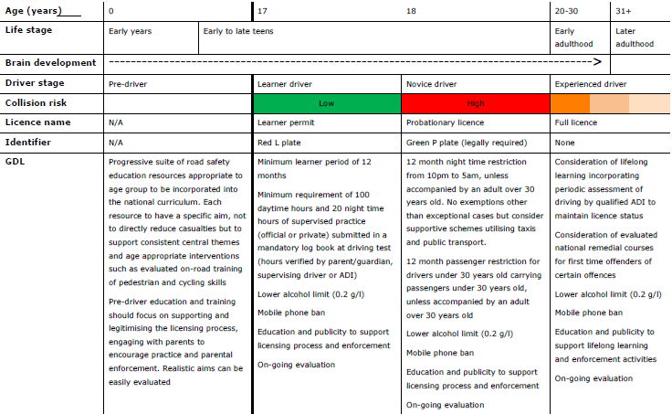
Proposed Driver Licensing in Great Britain (Kinnear et al., 2013)

Slide 29
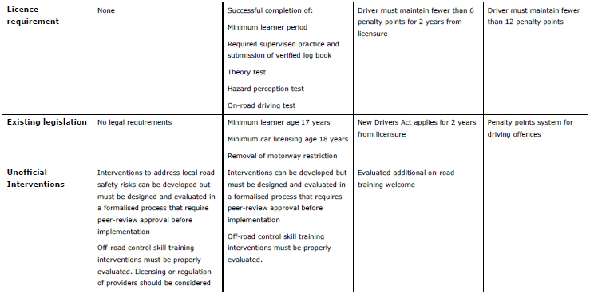
Proposed Driver Licensing in Great Britain

